Slide 1
Copper Mountain Mesa (CMM) Assessment District Annual Report
Presented 01/07/26

Slide 2

The Copper Mountain Mesa Assessment District was established in 1996 to finance water system improvements with bonds sold to the USDA as the sole bondholder. In March 1996, the District issued $4.55 million in bonds, secured by special assessments on property parcels collected via property tax bills. These bonds carry 4.5% interest, with payments due twice annually, and are set to be fully repaid by 2036.
As of June 2025, the outstanding principal bond balance was $1.75 million. nervousness
Summary

Slide 3
PROCESS
Collections Process from Property Owners
Special assessments are collected from property owners via their County-issued property tax bills, which are due in December and April. The County remits the collected funds to the District at scheduled times during the year. These funds are held in trust by the District and used to make the scheduled bond principal and interest payments to the USDA.
Delinquencies
After each tax payment due date, NBS prepares a delinquency report, and letters are sent to delinquent property owners. The initial delinquency rate reported as of 06/30/25 for the 08/01/24 billing was 12.78%. However, that rate typically drops to about 0% after five years when the County sells tax-delinquent properties and requires payment of outstanding bills. Thus, the overall delinquency rate for the Assessment District stood at 1.21%. No foreclosure covenant is in place.

Slide 4
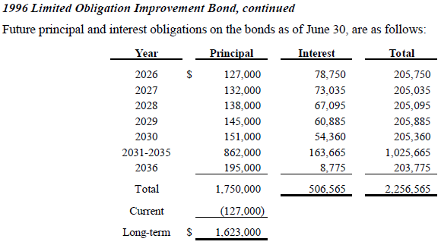
Selecting visual aids
1996 Limited Obligation Improvement Bond
In March 1996, the District authorized the issuance of $4,551,389 in Copper Mountain Mesa limited obligation improvement bonds pursuant to the provisions of the Municipal Improvement Act of 1913. The bonds are payable and secured solely by special assessments on property parcels and the special assessments are collected and paid by the District. The District is not obligated to, but may at its sole discretion, advance available surplus funds from the District treasury. The bonds bear an interest of 4.5% per annum. Principal and interest are payable September 2nd and March 2nd (interest only) of each year.
DISTRICT PAYMENT TO BONDHOLDER
Source: 2024/25 Audited Financial Statements

Slide 5
Annual Report
The 2024/25 Annual Report, prepared by NBS, provides a summary of the bond's financial status, including repayment schedules, billing details, and delinquency information. An abbreviated version is provided in the agenda packet and a full version is available at: https://tinyurl.com/CMMANNUAL24-25.
Continuing Disclosure Annual Report
Each year by December 31st, NBS, with input from District staff, prepares and files a Continuing Disclosure Report as required under U.S. Securities and Exchange Commission (SEC) Rule 15c2-12(b)(5). This report is submitted to the Electronic Municipal Market Access (EMMA) website along with the District’s most recent audited financial statements. An abbreviated version of the 2024/25 report is in the agenda packet, and the full version can be accessed at: https://tinyurl.com/CMMDISCLOSURE2025.
COMPLIANCE

Slide 6


QR CODES FOR REPORTS
2024/25 Annual Report
2024/25 Continuing Disclosure Report

Slide 7
POTENTIAL INTEREST PREPAYMENT
In 2026, the District intends to work with NBS, its CMM Assessment District Administrator, to evaluate and consider initiating a potential interest prepayment (or bond redemption) to be funded by an excess balance in the LAIF Redemption account. Through this process, the District would prepay the debt principal by an amount to be determined. This action would save the assessment district participants interest over the repayment term.

Slide 8
ADVANTAGE
Advantage of Original Participation
Original participants in the Copper Mountain Mesa Assessment District who connect to the water system now pay a lower charge (a “tract” charge) to the District for meter connection since their assessment costs cover the major infrastructure and service line installation work that was originally completed.

Slide 9

Speaking impact
Questions?
Thank you!

