Slide 1


Joshua Basin Water District
Water Rate Study
Preliminary Findings & Rate Scenarios
October 12, 2022
DRAFT

Slide 2

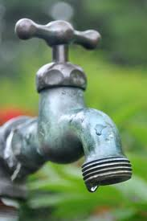

Presentation Overview
Background
Rates & Finances
Financial Challenges
Draft Rate Scenarios
Dedicated Capital Charge
Schedule & Next Steps
Goal: Discuss preliminary findings & draft rate scenarios and receive input

Slide 3
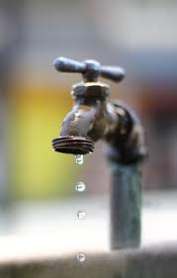
Rates & Finances
JBWD is a financially self-supporting government agency
Water rates are the main source of revenue and need to be
set at levels adequate to fund the costs of providing service
District has historically provided strong financial management
via annual rate increases phased in over many years
Last rate study completed in early 2018; final year increase effective Jan-1, 2022
  Evaluated a range of funding and rate alternatives
  District adopted substantial rate increases phased in over 5 years based on a “Reduced Rate Scenario”
  Less % increase to fixed charges & more to usage charges, steeper tiers
  Adopted rates were designed to take substantial steps in the right direction with the understanding that significant additional rate increases would be needed to support operating & capital needs including Chromium 6

Slide 4
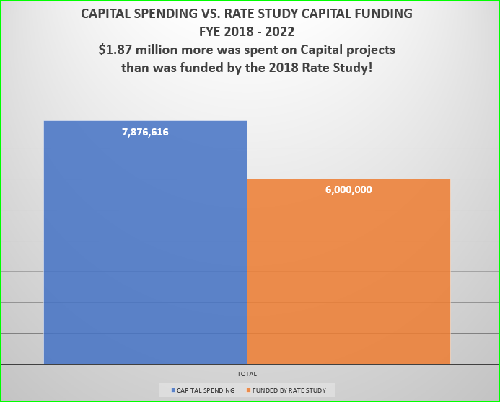

Slide 5
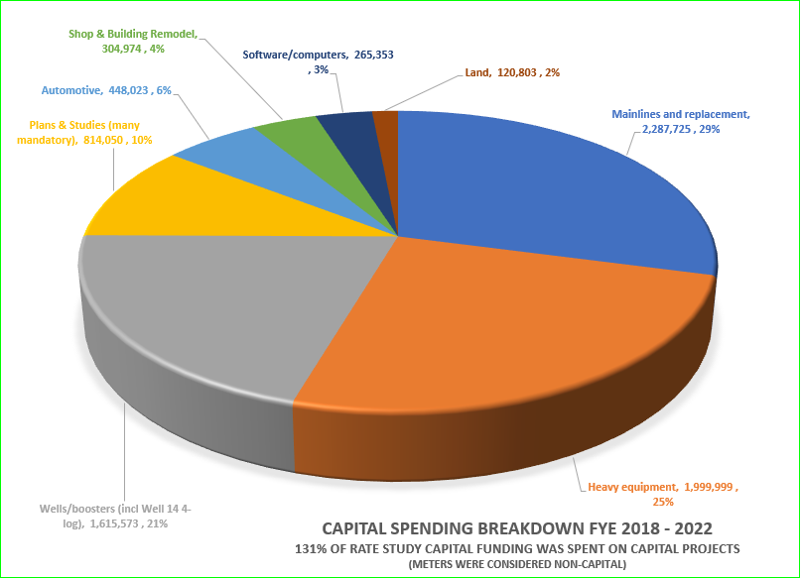
57,584 LF Mainlines Replaced! Saddleback, Tilford Ph I &. II

Slide 6
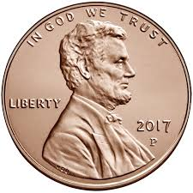
Current Water Rates
Fixed charges generate 38% of rate revenues
(target was 40%)
Average Rate =
slightly over
1 cent per gallon

Slide 7

Financial Challenges
Chromium 6 Project (Capital & Operating Costs)
  Needed to meet new, extremely-stringent regulatory requirements
  Capital project cost estimate = $18 million (preliminary)
  JBWD seeking grant & low-interest rate funding from the SRF financing program
  Projections assume $10M grant + $8M SRF Loan with ~$400K annual debt svc
  Annual operating & maintenance costs estimated at $750,000
Aging Infrastructure & Capital Improvement Needs
  $2.5+ million (current $) in annual funding needs for rehabilitation & replacement
  of aging infrastructure (boosters, wells, tanks, water meters & old pipelines)
  JBWD established a Capital Improvement & Replacement Program (CIRP) with
  in-house staffing to help construct capital improvements at lower cost
Long-Term Water Supply
  Ongoing funding needed to import water from Mojave Water Agency to mitigate groundwater overdraft; projections assume = 1,000 Acre-Feet per year
Ongoing Cost Inflation
  Rate increases are needed to keep revenues in line with cost inflation and
  escalating costs of providing service

Slide 8
Financial Projections
BWA worked with JBWD to develop 10-year cash flow projections to identify future funding needs and evaluate rate increases
Based on latest financial and utility billing data available and a number of reasonable and slightly-conservative assumptions including:
  Operating expenses based on current fiscal year budget (approx. $7.1M)
  Operating cost inflation projected at 6% next year then 4% per year thereafter
  Growth: New connection projected at 50 this fiscal year & 25 per year thereafter
  Assumes each 10% increase in water flow charges results in a 1% decrease in water use
  Add’l staffing (deferred & reduced): $45K per year increasing to $200K after 3 years
  Assumes $18M Chromium 6 Project funded by $10M Grant & $8M SRF Loan with $400,000 annual debt service
  Chromium 6 operating expenses est. at $750,000 per year starting in 2 years
  1,000 AF per year of imported water from MWA for groundwater recharge (~85% of demand)
  Equipment/Technology: $375K and Studies/Reports: $200K (reduced from initial estimates)
  Meter Replacement Program: $185K for 7 years then $50K per year (reduced from initial ests)
  New Admin Building: excluded
  Capital improvement annual funding target $2,500,000 + 3.5% escalation per year

Slide 9

Draft Rate Scenarios
To support operating and capital needs and the Chromium 6 Project over the next 5 years, rate increases in line with the 2018 projections are needed.
Evaluated a range of financial & rate scenarios
  Best Management Practice with Reduced Expenses
  Reduced Rate Increases with Add’l Drawdown of Fund Reserves
  Limit Overall Rate Increases to 9% Per Year & Reduce CIP
  Dedicated/Restricted Capital Improvement Charge (On Bill or Tax Roll)
Tradeoffs with different levels of rate increases
  Level of funding for capital improvements
  Drawdown of fund reserves
  Near-term vs. longer-term capital funding & rate increases
  More rate increases in first 5 years = less in future & vice versa
  Balance of competing objectives

Slide 11
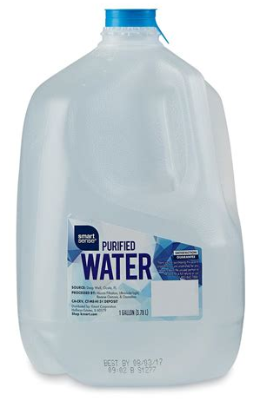

Slide 12
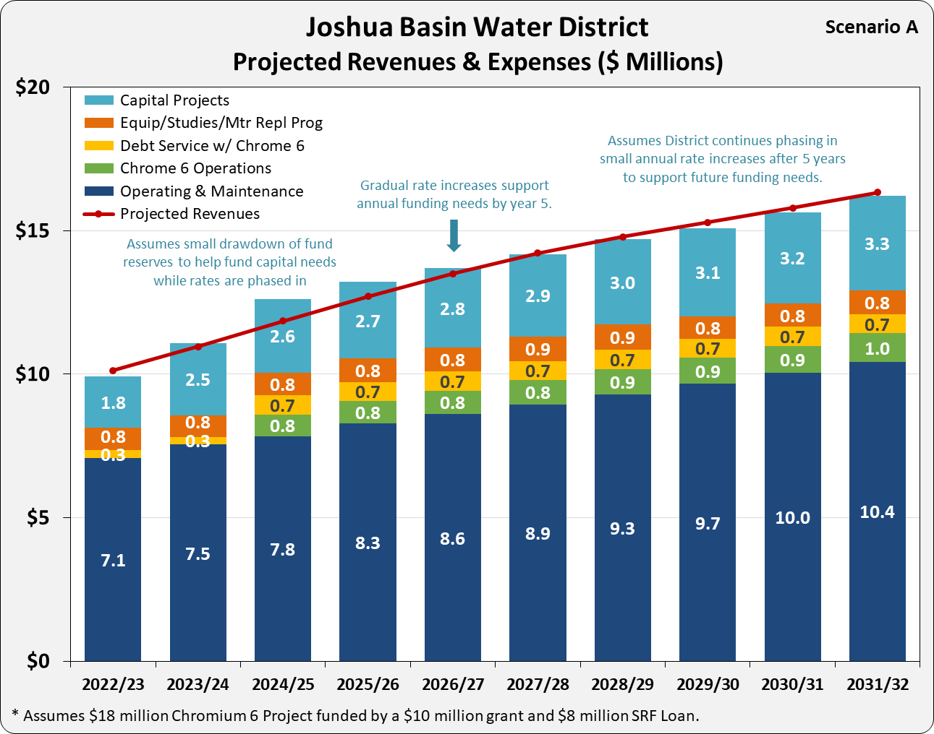
16% 14% 12% 10% 8% 4% 4% 4% 4% 4%

Slide 13
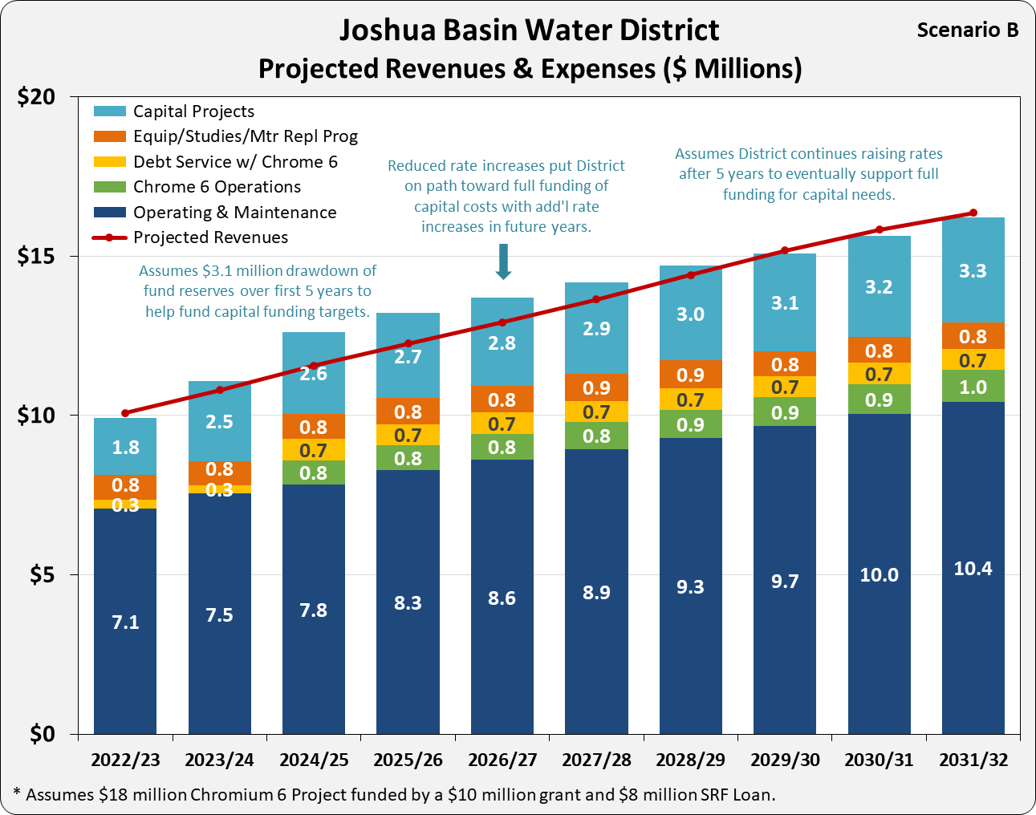
14% 12% 10% 8% 8% 8% 8% 6% 4% 4%

Slide 14
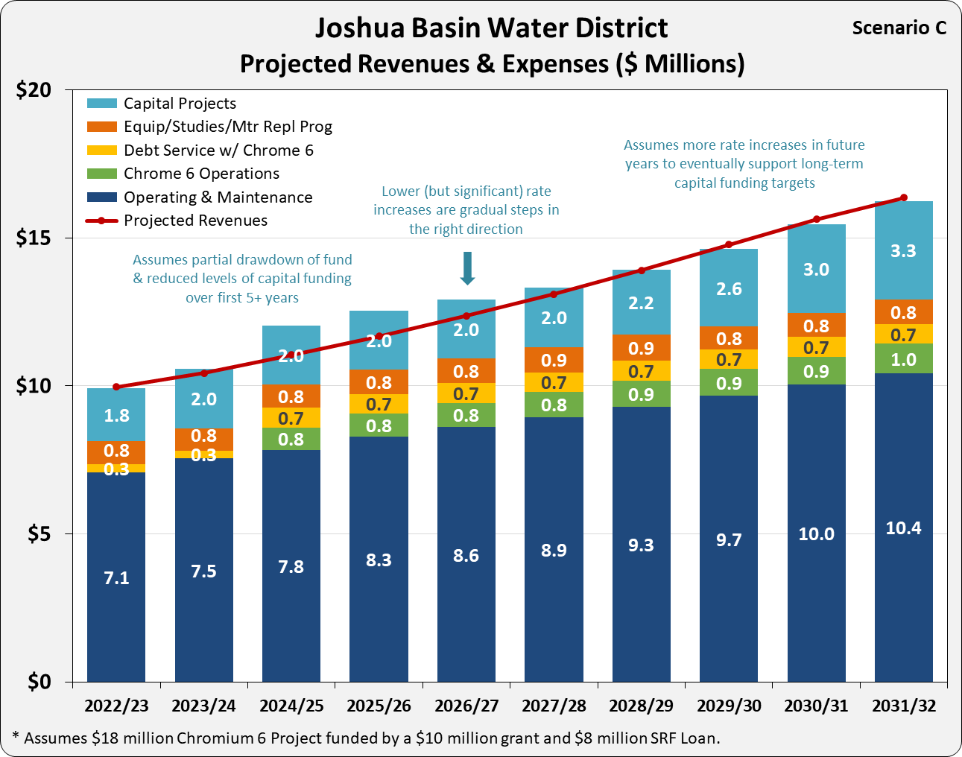
9% 9% 9% 9% 9% 9% 9% 9% 6% 6%

Slide 15
Dedicated Capital Charge
Restricted funding source for capital improvements (option)
  Can be used to fund capital projects, debt service, and CIRP program staff
Can be collected via County property tax rolls
  Relatively easy to administer (similar to Standby Charges, checked with NBS)
  Keeps monthly water bills reasonable
Could result in no regular water rate increases for up to 5 years
Nexus of benefit with property
  Water system designed to provide service capacity & fire flow benefit to each property
  Infrastructure benefits property regardless of use; operations would be funded by rates
Property-owners would be responsible for bill (not renters)
  Landlords can potentially pass through charges (depending on current & future lease)
Options:
  Charges can be a fixed charge based on meter size (e.g. similar to Capacity Charge)
  Charges can be phased in (e.g. over 5 years) with flexibility to adjust each year
  Can adopt a blend of capital charges and rate increases

Slide 16
Key Issues for Input
Level of rate increases to consider for Prop 218 Process for next 5 years
Level of increases to fixed monthly charges vs. water usage rates
Concept of a Dedicated/Restricted Capital Charge instead of rate increases
Potential for collecting a Capital Charge on the property tax rolls
Potential for pursuing Prop 218 adoption of drought rate surcharges
We welcome your input on any other issues

Slide 17
Draft Rate Study Process
Aug-31 Board Meeting – Water rate study introduction & receive initial input
Sep-13 CAC Meeting – Water rate study introduction & receive initial input
Oct-12 Special Joint Board & CAC Workshop – Discuss preliminary findings
and draft alternatives and receive input
Nov-8 CAC Meeting – Continue evaluating & honing recommendations
Nov-9 Special Joint Board & CAC Workshop - Continue evaluating & honing recommendations
Mid-Dec Special Board Meeting – Review & finalize recommendations, seek direction to move forward with Prop 218 Process
Late-Dec Mail Prop 218 Notices at least 45 days prior to date of Public Hearing
Jan-10 Community Workshop
Feb-15 Board Meeting – Public Hearing on proposed rates
Mar-1 Goal: New rates effective starting March 1, 2023 with future increases effective January 1 each year

Slide 18

Questions &
Discussion

