Slide 1

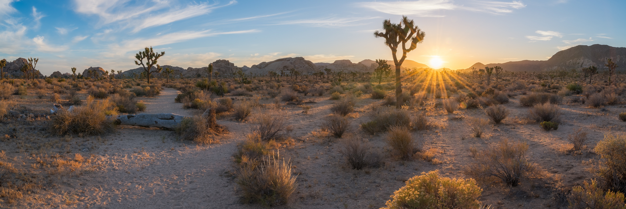
JOSHUA TREE SEPTIC TO SEWER PROJECT
Notes:
Introductions:

Slide 2
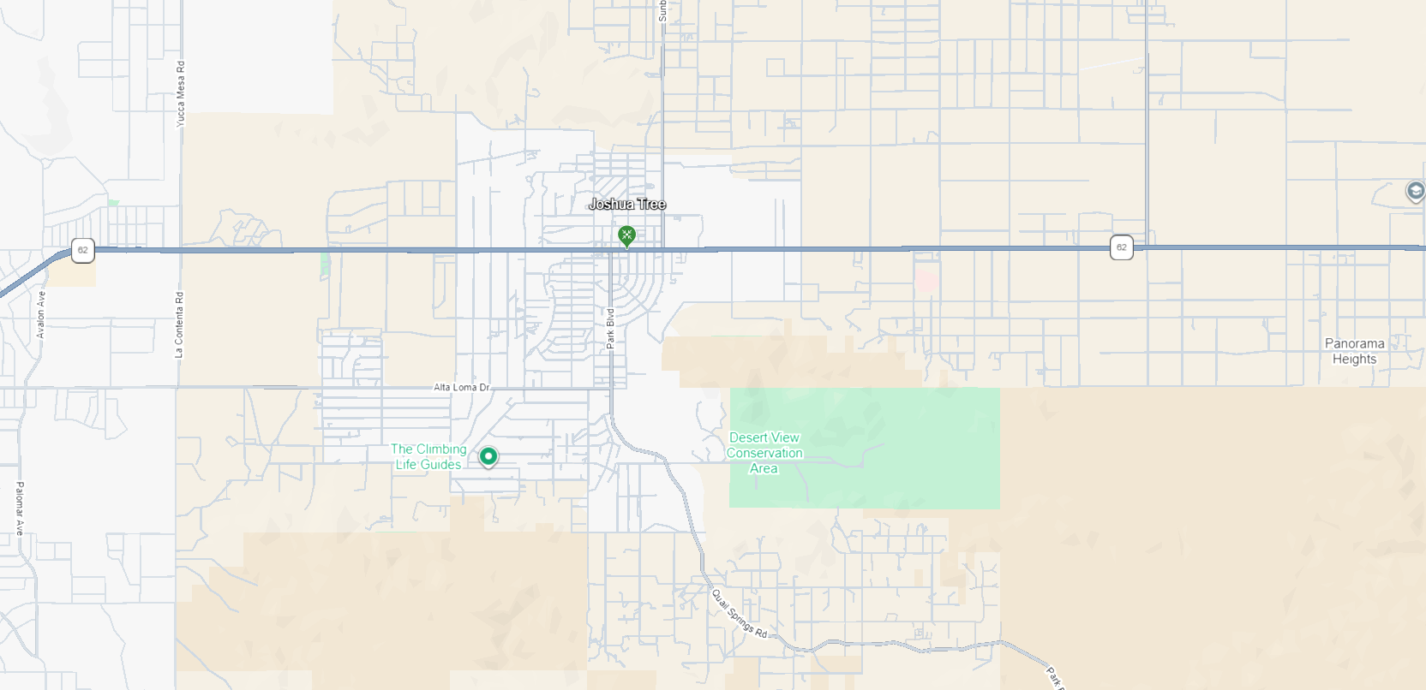
JOSHUA TREE SEPTIC TO SEWER PROJECT

Slide 3
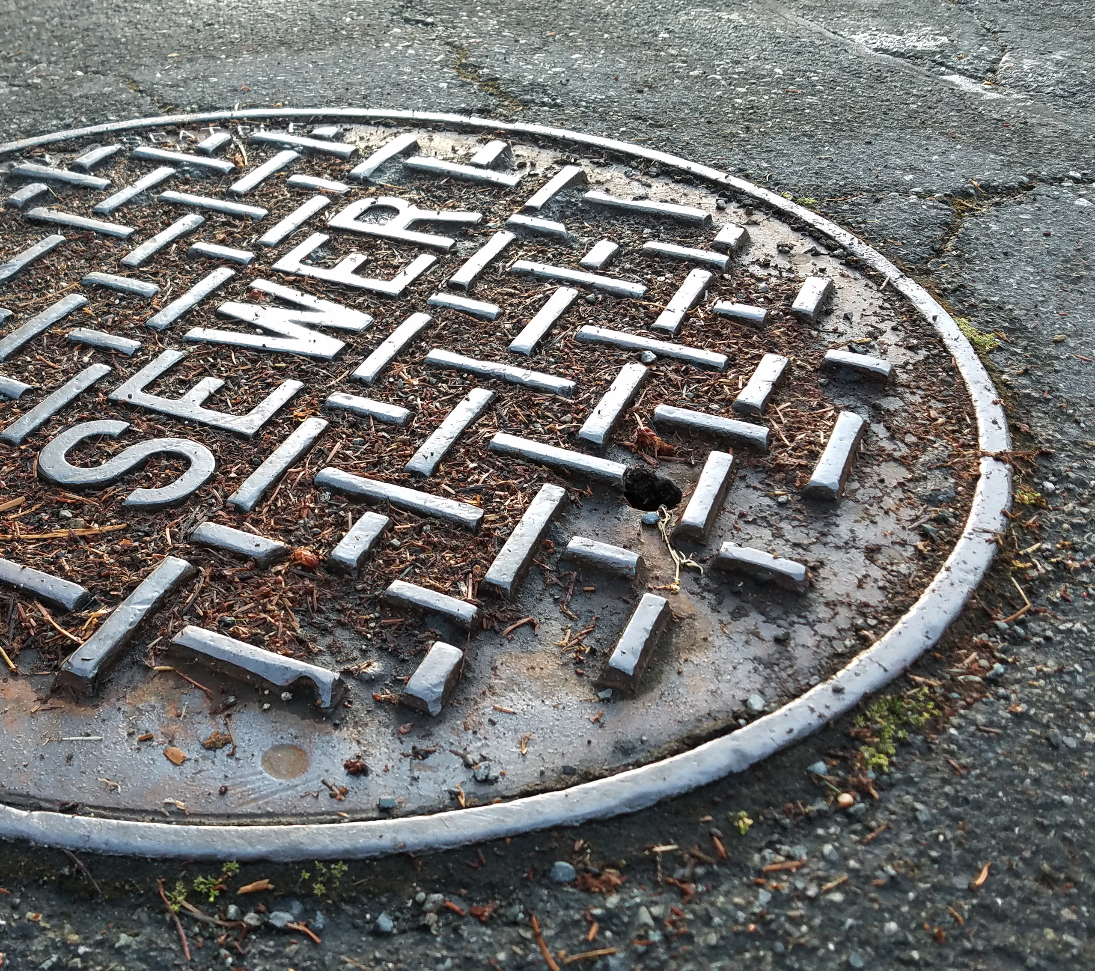
PRESENTATION OVERVIEW
Page 3
Why this project is needed
How it may protect local groundwater
Funding sources
Project scope and what will be studied
Preliminary timeline
What this means for property owners
Upcoming public engagement opportunities
- Special Districts Mission Statement
Snowdrop Road Ribbon Cutting April 2023
Notes:
Tonight we’ll provide an overview of the County’s efforts to evaluate a future sewer service system for the Joshua Tree community.
We will cover: • Why this project is needed • How it may protect local groundwater • Funding sources • Project scope and what will be studied • Preliminary timeline • What this means for property owners • Upcoming public engagement opportunities

Slide 4
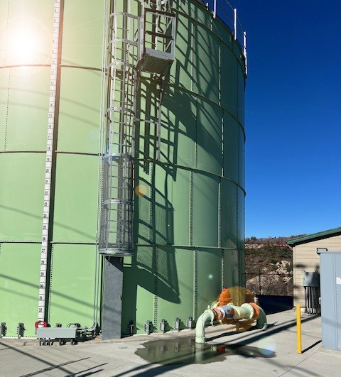
PROJECT PURPOSE AND NEED
Page 4
Joshua Tree relies on local groundwater from the Morongo Basin.
Up to 80% of groundwater recharge comes from septic systems.
Over time, this may increase nitrates and dissolved solids.
A sewer system could help protect groundwater quality and long-term sustainability.
County is evaluating options; no decision to construct has been made.
- Special Districts Mission Statement
Notes:
The unincorporated community of Joshua Tree relies on local groundwater from two parts of the Morongo Groundwater Basin. Today, septic systems contribute up to 80% of the water that refills the basin. Over time, this can increase contaminants such as nitrates and dissolved solids.
To protect drinking water and support long‑term sustainability, septic systems will eventually need to be replaced with modern treatment solutions that better clean wastewater before it returns to the environment.

Slide 5
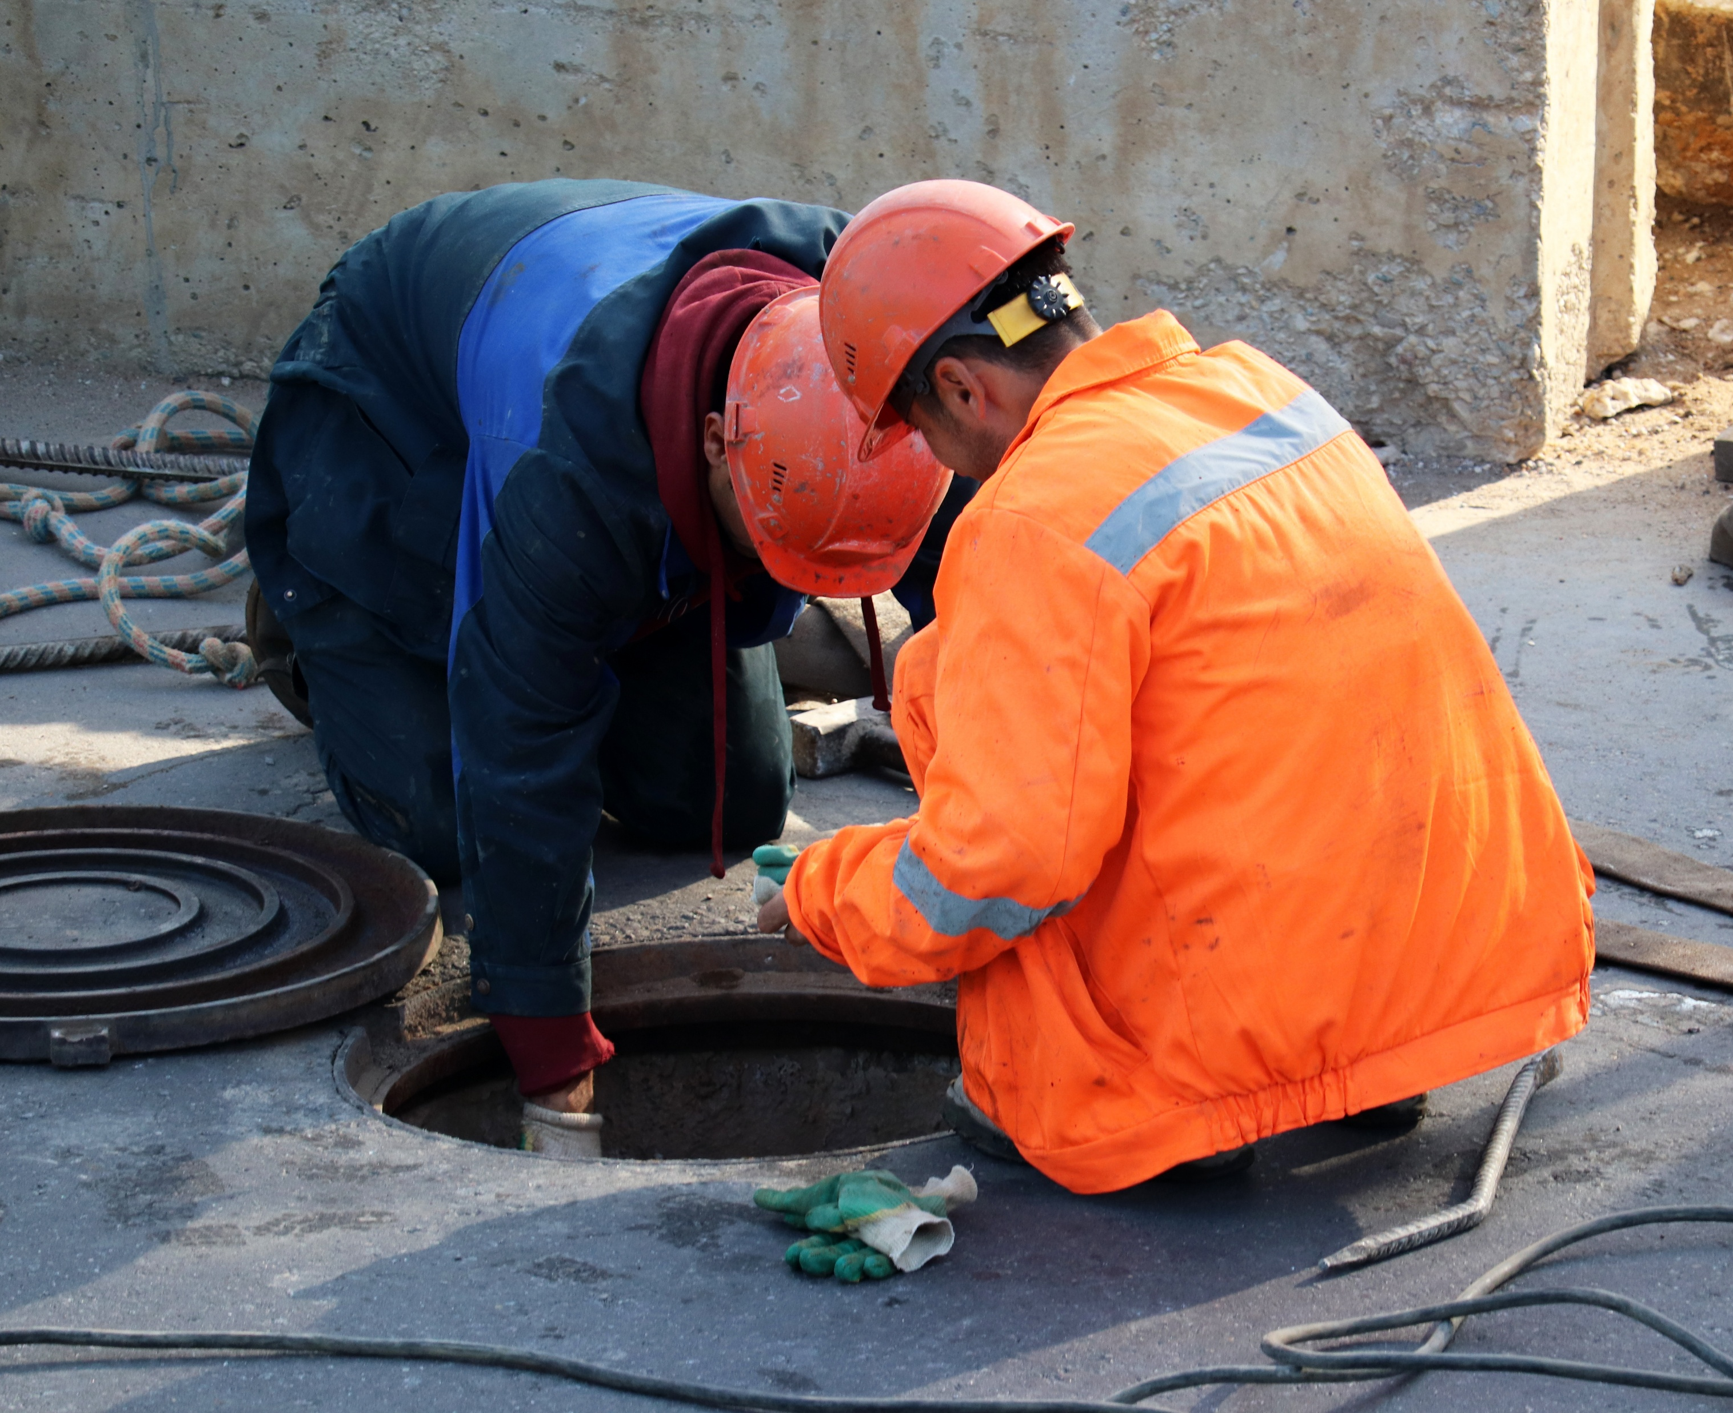
PROJECT FUNDING
Page 5
$6.3M from 3rd District Discretionary General funds has been allocated for district formation, LAFCO, site acquisition, planning, and preliminary design concepts.
$750K Federal Earmark from U.S. Congressman Jay Obernolte California’s 23rd District
Further funding to be identified for later phases of the project.
- Special Districts Mission Statement
Snowdrop Road Ribbon Cutting April 2023
Notes:
Funding secured to date includes:
• San Bernardino County 3rd District Funds: $6.3 million for district formation, LAFCO processing, site acquisition, and preliminary planning. • Federal Funding: $750,000 from Congressman Jay Obernolte (California’s 23rd District). • Additional funding sources will be identified for future phases such as design and construction.

Slide 6
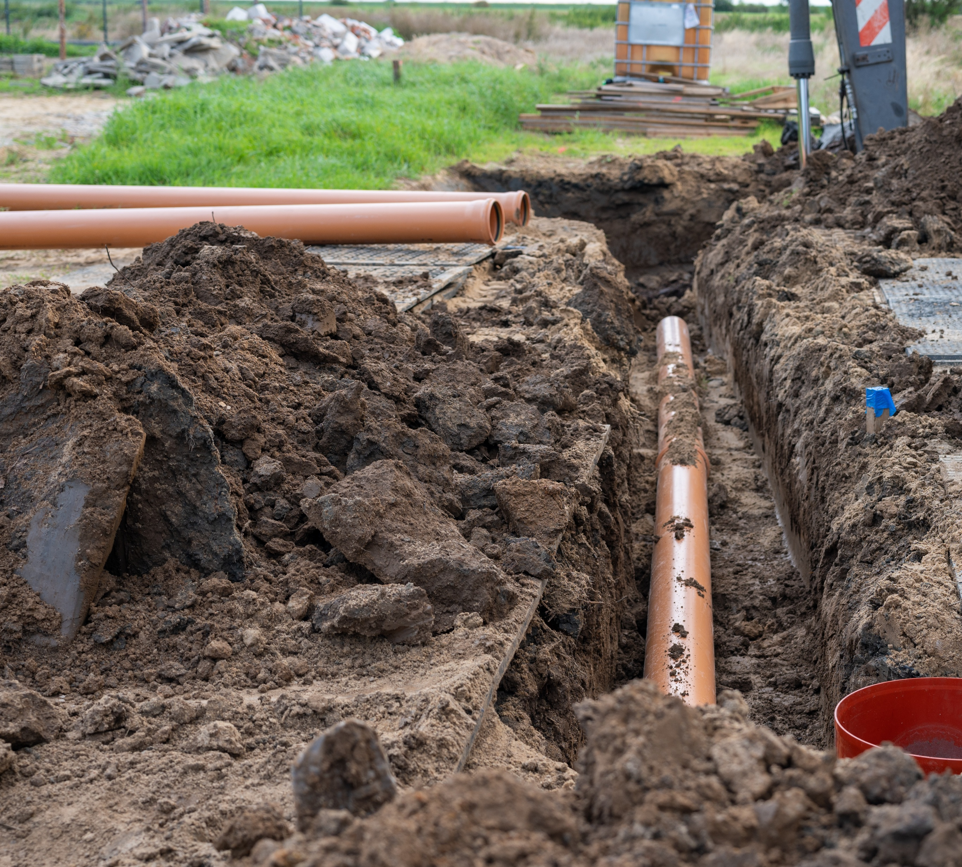
PROJECT SCOPE
Page 6
County-led study and technical analysis
Community engagement
District formation and LAFCO review
Formation includes public outreach and a property-owner vote
Land acquisition for future facilities
Environmental studies and clearances
No construction in this phase
- Special Districts Mission Statement
Notes:
Over the next 2-3 years, the County will complete:
• A county‑led study and technical analysis • Community engagement
District formation and LAFCO review • Land acquisition for future facilities • Environmental studies and clearances
This phase does not include construction. It focuses on research, planning, and defining community needs.

Slide 7
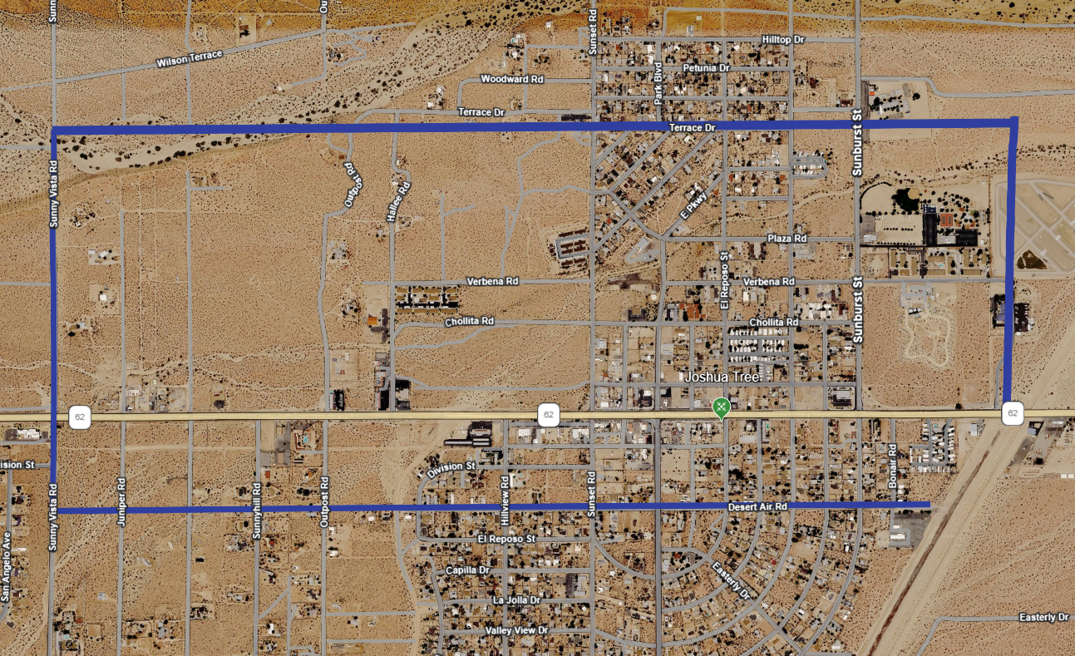
PRELIMINARY COUNTY STUDY AREA
Page 7
Evaluated based on development patterns and environmental constraints.
General boundary references:
– Terrace Dr (North)
– Verbena Rd (East)
– Sunny Vista (West)
– Desert Air Rd (South)
Notes:
As part of the County’s project, a new study area will be evaluated based on population, development patterns, environmental constraints, and historical preservation needs.

Slide 8
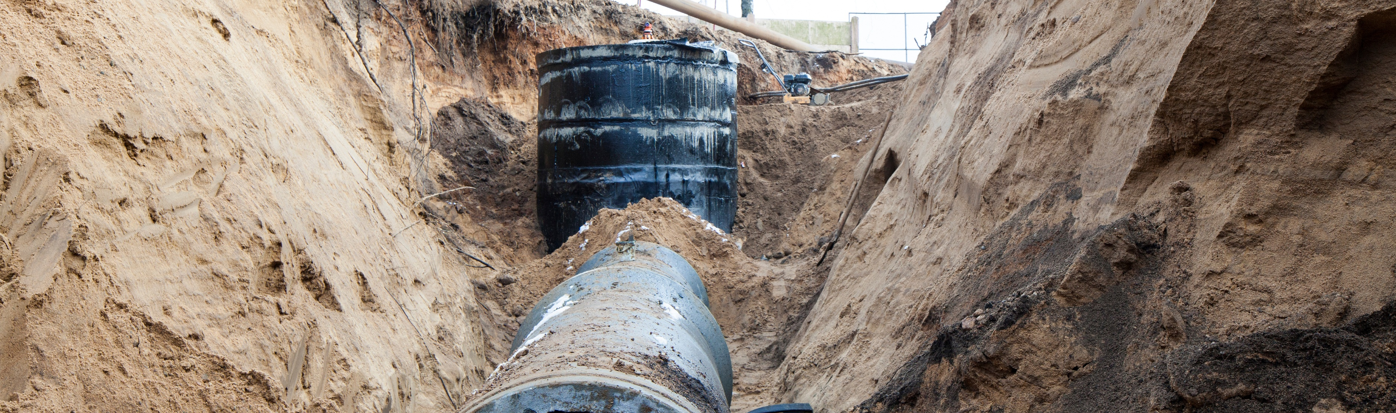
PROJECT TIMELINE
Page 8
Strategic Studies
Public Outreach
Environmental
Studies
Environmental Clearances
Planning and Preliminary Design
- Special Districts Mission Statement
Snowdrop Road Ribbon Cutting April 2023
Notes:
Key planning activities will occur over several years:
• Strategic studies • Public outreach and community input • Environmental studies • Environmental clearances • Planning and preliminary design activities
This timeline emphasizes that no construction is occurring at this stage.

Slide 9
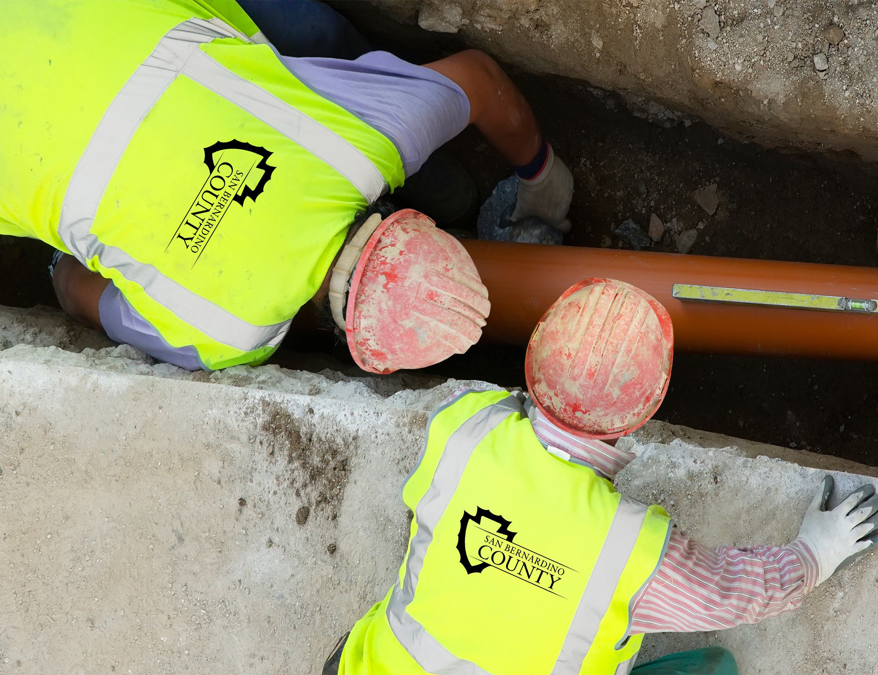
WHAT PROPERTY OWNERS NEED TO KNOW
Page 9
No action required at this time
No physical work will occur during this phase
County is collecting data and evaluating solutions
Community feedback opportunities will be provided
District formation requires a property-owner vote
Snowdrop Road Ribbon Cutting April 2023
Notes:
At this time:
• No action is required from property owners • No physical work is being performed on properties • The County is currently collecting data and evaluating potential solutions • Community feedback will be gathered through upcoming outreach meetings and surveys
District formation requires a property-owner vote

Slide 10
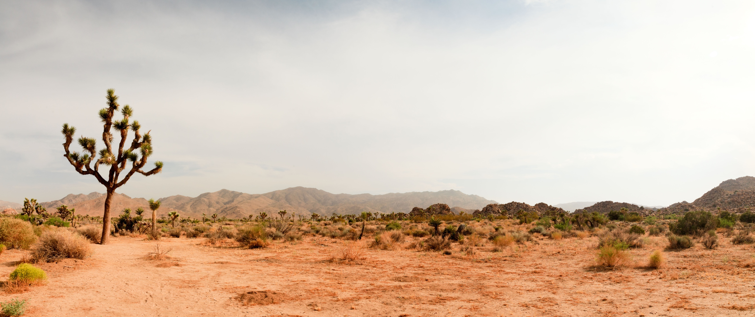

QUESTIONS
Page 10
For project updates and additional information, visit our website at https://specialdistricts.sbcounty.gov/
CONTACT: Noel Castillo Director San Bernardino County – Public Works
- Special Districts Mission Statement
Snowdrop Road Ribbon Cutting April 2023

