Slide 1
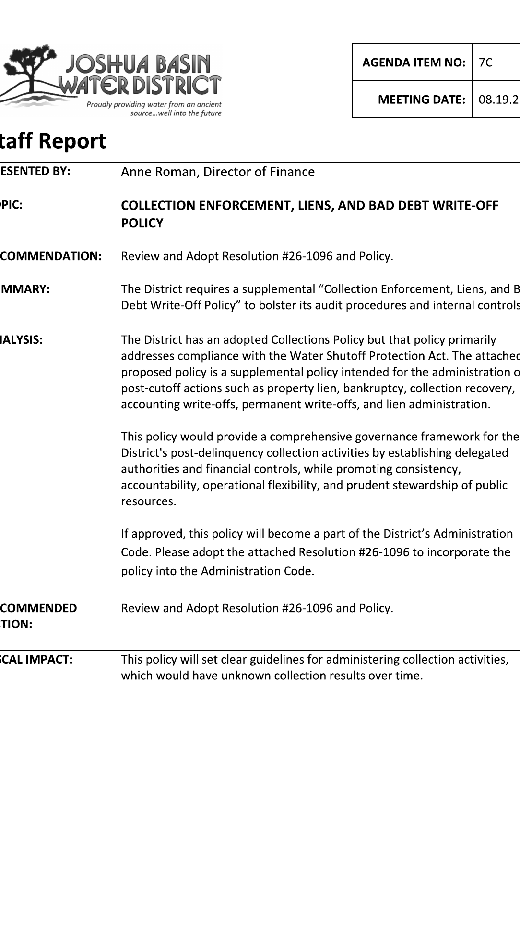
COLLECTION
ENFORCEMENT
POLICY
✓
Recommended Action
Review and adopt Resolution No. 26-1096 and Policy.
◈
Policy Focus
Liens and Bad Debt Write-Off Policy
Collection enforcement, property liens, bankruptcy, write-offs, reporting, and controls.
$
Fiscal Impact
Clear guidelines for collection activities; results will be unknown over time.
Staff Report
Agenda Item 7C • August 19, 2026
Joshua Basin Water District
1
Notes:
[Sources]
Agenda Item 7C staff report identifies the topic as “Collection Enforcement, Liens, and Bad Debt Write-Off Policy” and recommends reviewing and adopting Resolution No. 26-1096 and the policy. Fiscal impact states the policy will set clear guidelines for collection activities with unknown collection results over time. Source: Agenda 08-19-26.pdf, page 21.

Slide 2
Why This Policy Is Before the Board
A supplemental framework to make post-delinquency actions consistent and administrable.
!
Need
⊙
Policy Gap
↗
Result
The existing Collections Policy primarily addresses compliance with the Water Shutoff Protection Act.
Post-delinquency actions such as liens, bankruptcy, collection recovery, write-offs, and reporting need a defined governance framework.
Administration gains authority, standards, internal controls, accountability, and operational flexibility.
Supports fair, consistent, and lawful recovery
Joshua Basin Water District
2
Notes:
[Sources]
Staff report states the policy is intended to supplement the existing Collections Policy by addressing post-delinquency collection activities such as property lien, bankruptcy, collection recovery, accounting write-offs, permanent write-offs, and lien administration. Source: Agenda 08-19-26.pdf, page 21.

Slide 3
What the Policy Establishes
A complete structure for collection rights and decision-making.
Philosophy
Fair, consistent, nondiscriminatory collection actions
Policy
Intent
Legal remedies
Property liens and other post-delinquency remedies
Consistency
Accountability
Operational flexibility
Public stewardship
Write-offs
Accounting and permanent write-off standards
Delegation
Defined authority for GM/designee and Board
Controls
Reporting, records, audit, and documentation requirements
Joshua Basin Water District
3
Notes:
[Sources]
Article 1 states the policy establishes the District’s collection enforcement philosophy, authority for property liens and remedies, procedures for accounting and permanent write-offs, authority for administrative action, Board oversight responsibilities, and standards for preserving collection rights. Source: Agenda 08-19-26.pdf, page 26.

Slide 4
Collection Activity Pathway
Progressive collection steps remain flexible and must be cost-effective.
1
☰
2
↺
3
⚖
4
$
5
✓
Billing
Delinquency
Lien tools
Recovery
Write-off
Regular billing and account notices
Delinquency notices and payment arrangements
Intent to file, record, renew, or release liens
Monitor sales, claims, collections, excess proceeds
Accounting or permanent write-off when criteria are met
Guiding principle:
Actions should be reasonably proportional to expected recovery
and avoid unnecessary expenditure of public resources.
Joshua Basin Water District
4
Notes:
[Sources]
Article 4 describes a progressive collection approach that may include regular billing, delinquency notices, payment arrangements, discontinuation of service where authorized, intent to file lien notices, recorded lien activity, bankruptcy activity, claims for excess proceeds, referrals, accounting write-offs, and permanent write-offs. Article 4.03 states collection actions should be reasonably proportional to expected recovery. Source: Agenda 08-19-26.pdf, pages 29-30.

Slide 5
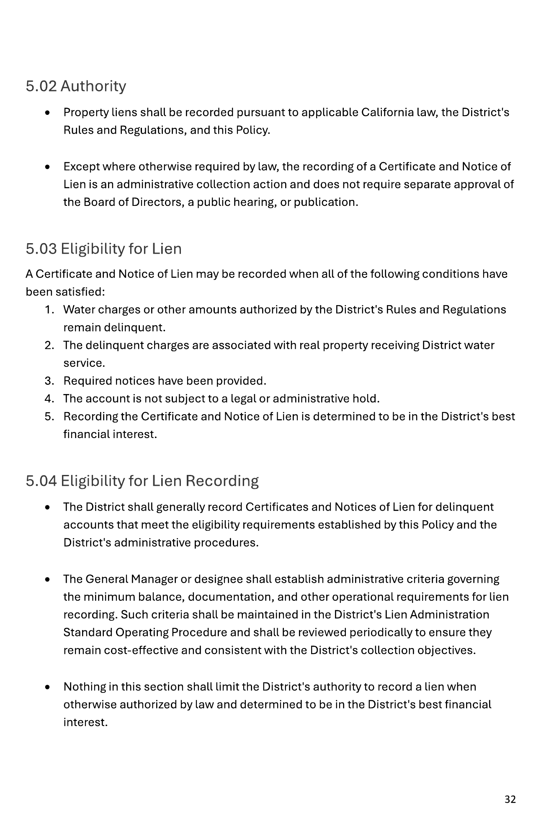
Property Lien Framework
Lien authority protects District revenues while preserving procedural safeguards.
Eligibility
Notice
1
2
Charges remain delinquent, service is tied to real property, required notices are provided, and recording is in the District’s best financial interest.
The District generally provides an Intent to File Lien and allows at least 30 calendar days before recording.
Recoverable Costs
Administration
3
Lien amounts may include unpaid charges, penalties, interest, recording fees, release fees, and other lawful charges.
4
A lien register tracks owner, APN, recording number/date, balance, expiration, release status, and renewal status.
Recorded liens generally remain effective for ten years
unless satisfied, released, or extinguished.
Eligibility & recording
Joshua Basin Water District
5
Notes:
[Sources]
Article 5 contains property lien provisions. Section 5.03 defines eligibility conditions, Section 5.06 describes notice requirements, Section 5.07 lists recoverable costs, Section 5.09 requires a lien register, and Section 5.10 states a recorded Certificate and Notice of Lien generally remains effective for ten years unless satisfied, released, or extinguished. Source: Agenda 08-19-26.pdf, pages 32-35.

Slide 6
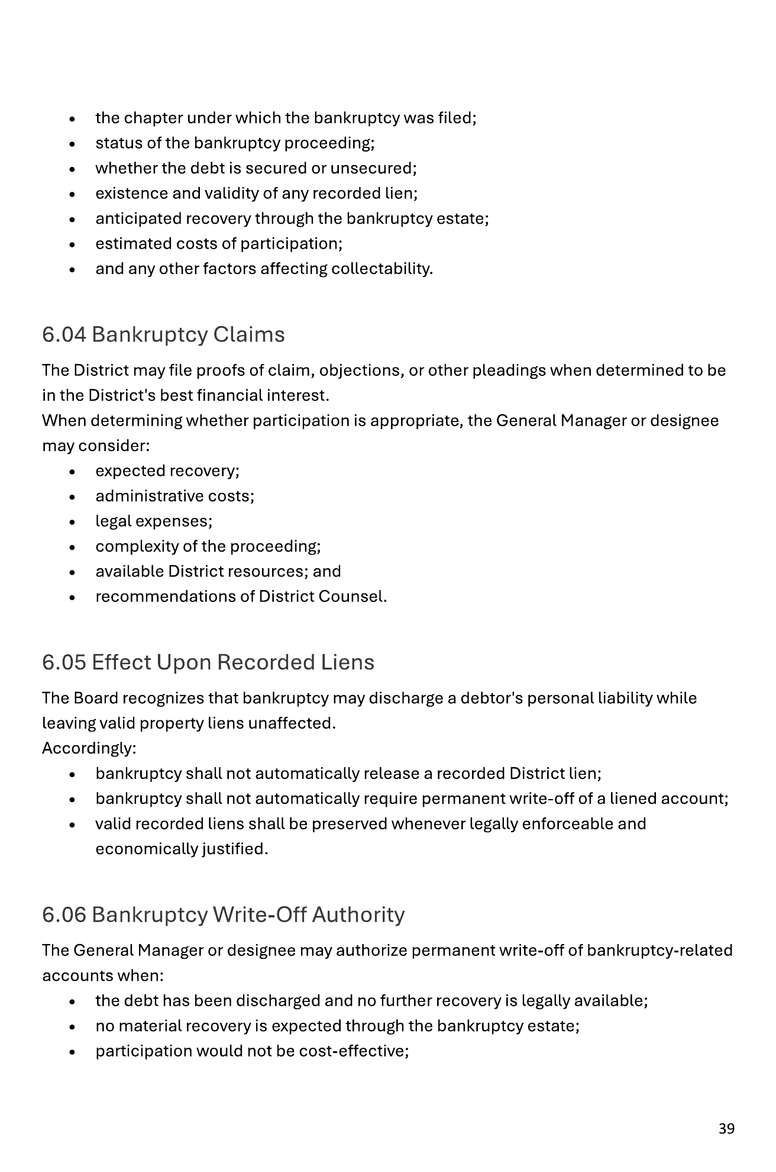
Bankruptcy: Stay Compliance + Rights Preservation
The policy separates lawful collection preservation from prohibited collection activity.
Cease prohibited collection activity
Evaluate case facts
automatic stay
chapter, status, lien validity, expected recovery
BANKRUPTCY
NOTICE
Document write-off basis
File claims when appropriate
case number, discharge, liens, consultation
proofs of claim, objections, pleadings
Bankruptcy provisions
Joshua Basin Water District
6
Notes:
[Sources]
Article 6 states that collection activities prohibited by law cease immediately upon receipt of a bankruptcy filing notice, while the District may exercise rights authorized under the Bankruptcy Code. It also provides for evaluation of cases, bankruptcy claims, effect upon recorded liens, write-off authority, and documentation. Source: Agenda 08-19-26.pdf, pages 38-40.

Slide 7
Accounting Write-Off vs. Permanent Write-Off
Write-offs clean up accounting records but do not automatically forgive debt or release valid liens.
▣
◆
Accounting Write-Off
Permanent Write-Off
• Removes receivable from active accounting records
• Improves financial statement accuracy
• Does not extinguish debt
• Does not release liens or prevent future recovery
• Administrative determination that collection is no longer warranted
• May follow expiration, lien extinguishment, bankruptcy discharge, or other uncollectible criteria
• Does not impair a valid recorded lien by itself
Future recoveries after write-off are still accepted and recorded as revenue.
Joshua Basin Water District
7
Notes:
[Sources]
Article 7 defines accounting write-offs as removal from active receivables for accounting purposes while preserving legal rights, and states accounting write-offs are not forgiveness of debt. Article 8 states permanent write-offs recognize accounts that have reached the end of practical or legal collection efforts and do not release or impair valid recorded liens by themselves. Source: Agenda 08-19-26.pdf, pages 40-44.

Slide 8
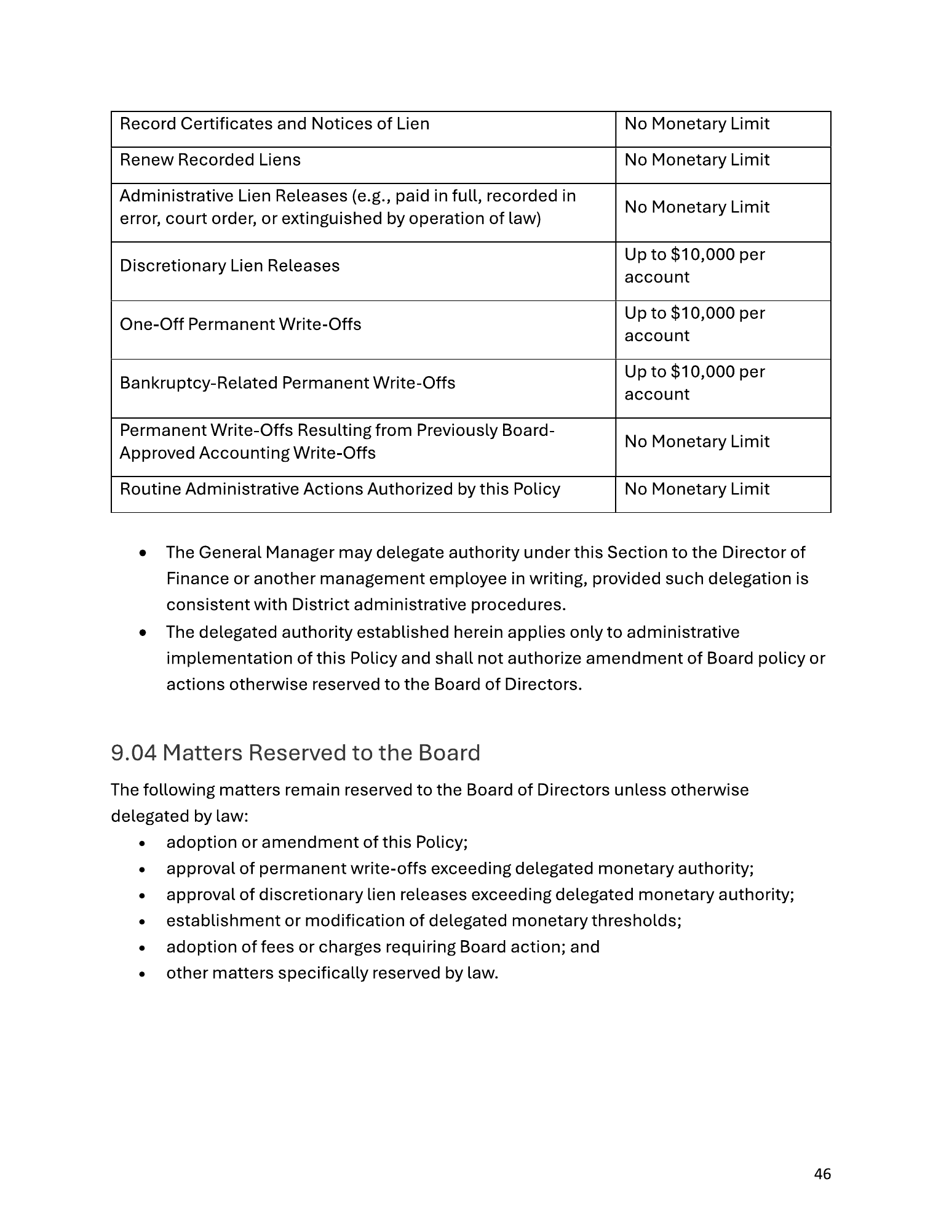
Delegation of Authority
Routine administration moves to the General Manager/designee; policy and threshold decisions remain with the Board.
Administrative action
GM / Designee
Board
Record / renew liens
No monetary limit
—
Administrative lien releases
No monetary limit
—
Discretionary lien releases
≤ $10,000 per account
> $10,000
One-off permanent write-offs
≤ $10,000 per account
> $10,000
Bankruptcy-related permanent write-offs
≤ $10,000 per account
> $10,000
Annual accounting write-offs
Recommend
Approve
Monetary authority table
Delegation does not amend Board policy or
override Board-reserved actions.
Joshua Basin Water District
8
Notes:
[Sources]
Article 9 delegates routine collection administration to the General Manager or designee and lists monetary authority. Matters reserved to the Board include adoption or amendment of the policy, permanent write-offs exceeding delegated authority, discretionary lien releases exceeding delegated authority, threshold changes, fees or charges requiring Board action, and matters reserved by law. Source: Agenda 08-19-26.pdf, pages 45-46.

Slide 9
Oversight, Reporting, and Internal Controls
The policy creates a control environment for consistent administration.
▤
Periodic Reports
✎
Documentation
Accounting write-off report and exceptional matter reporting
Compliance, factual basis, and appropriate authorization
▦
Records
◉
Review
Retention schedule, lien register, and collection records
Periodic audit by management, auditors, or authorized reviewers
Control objective: accurate reporting, consistent administration, segregation of duties, preservation of public assets, and legal compliance.
Joshua Basin Water District
9
Notes:
[Sources]
Article 10 requires periodic information sufficient for Board oversight, including annual accounting write-off reporting and exceptional matter reporting. Article 11 requires internal controls for accurate financial reporting, consistent administration, appropriate segregation of duties, preservation of public assets, and compliance with law, plus documentation, record retention, and audit provisions. Source: Agenda 08-19-26.pdf, pages 47-49.

Slide 10
Board Action and Takeaways
Resolution No. 26-1096 incorporates the policy into the Administration Code.
1
Completes the post-delinquency framework
Recommended
Action
Captures liens, bankruptcy, recovery, write-offs, reporting, and controls.
Review and adopt Resolution No. 26-1096 and the Collection Enforcement, Liens, and Bad Debt Write-Off Policy.
2
Balances recovery with fairness
Collection actions remain fair, consistent, nondiscriminatory, and cost-effective.
Effective upon adoption
3
Clarifies authority
Delegation enables routine administration while preserving Board oversight.
Joshua Basin Water District
10
Notes:
[Sources]
Resolution No. 26-1096 orders the policy set forth in Exhibit A as the District’s formal policy governing post-delinquency collection enforcement, property liens, bankruptcy matters, accounting write-offs, permanent write-offs, delegated authority, reporting, and related internal controls. Resolution states it takes effect immediately upon adoption. Source: Agenda 08-19-26.pdf, pages 22-24 and 50.

