Slide 1

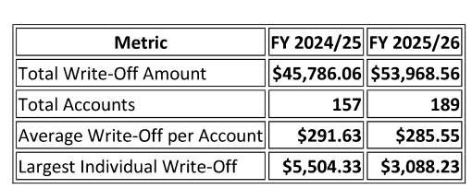
2025/26 Bad Debt Write-Off
Audit-required accounting action for Board approval
$53,968.56
189
88%
Proposed FY 2025/26 write-off
Customer accounts
Of $61,000 budget
What the Board is approving
An accounting write-off required for audit purposes. It does not forgive or extinguish the underlying debt and does not prevent future collection if opportunity arises.
Recommended action: approve the 2025/26 Bad Debt Write-Off.
Presented in Agenda Item 7B
Agenda Item 7B • Bad Debt Write-Off • 1
Notes:
Sources
Agenda 08-19-26.pdf, Agenda Item 7B: Staff Report and Bad Debt Write-Off analysis, pages 18-20.
Speaker notes
Open by emphasizing that the item is an accounting action, not a waiver of collection rights. Mention the requested action and the three headline figures.

Slide 2
Snapshot
The proposed write-off is modest relative to budget and water revenues, but customer mix highlights where risk remains.
$53,969
0.69%
189
$285.55
Total write-off
Of 2025/26 water revenues
Accounts included
Average per account
The write-off totals 88% of the $61,000 budget and consists primarily of relatively small final bill balances rather than large individual delinquencies.
Staff indicates this is an annual audit requirement and does not terminate the District’s legal right to collect where remedies remain available.
Accounting treatment
Collection rights preserved
Board approval requested
FY 2025/26 budget impact
Agenda Item 7B • Bad Debt Write-Off • 2
Notes:
Sources
Agenda 08-19-26.pdf, Agenda Item 7B: Staff Report and Bad Debt Write-Off analysis, pages 18-20.
Speaker notes
Use this slide as the short verbal summary: the amount, scale, and reason for the write-off. Clarify that the write-off improves financial reporting accuracy.

Slide 3
Year-over-year change
The increase is driven by more accounts, while average write-off per account declined slightly.
Staff report table, page 18
Average declined from $291.63 to $285.55
Largest individual write-off declined from $5,504.33 to $3,088.23.
+$8,182.50 (+17.9%) total write-off
+32 accounts (+20.4%) included
Agenda Item 7B • Bad Debt Write-Off • 3
Notes:
Sources
Agenda 08-19-26.pdf, Agenda Item 7B: Staff Report and Bad Debt Write-Off analysis, pages 18-20.
Speaker notes
The core takeaway is that the higher write-off total reflects a broader set of relatively small balances, not a spike in large delinquencies.

Slide 4
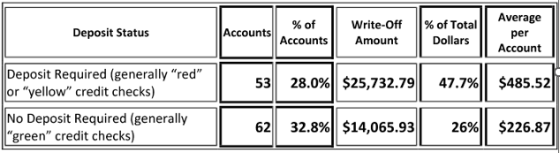
Deposit status: risk signal is working
Customers required to provide deposits are a minority of accounts but nearly half of write-off dollars.
$485.52
Avg. per account when a deposit was required
Deposit-required customers account for 28.0% of accounts and 47.7% of dollars.
This supports the effectiveness of the District’s risk-based deposit program in identifying higher-risk customers.
Share of accounts
Share of dollars
Deposit status table, page 18
Agenda Item 7B • Bad Debt Write-Off • 4
Notes:
Sources
Agenda 08-19-26.pdf, Agenda Item 7B: Staff Report and Bad Debt Write-Off analysis, pages 18-20.
Speaker notes
Point out the contrast between account share and dollar share. Security deposits appear to identify a higher-risk population, but write-offs still occur if accounts close with remaining final bills.

Slide 5
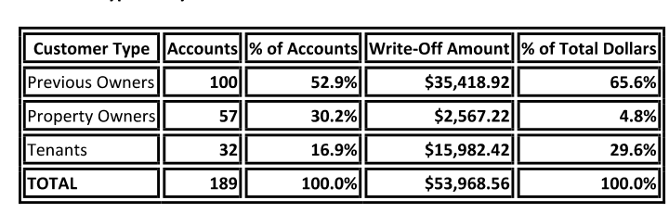
Customer type: most dollars come from closed accounts
Prior owners and tenants create the highest remaining exposure after service termination.
65.6%
29.6%
of write-off dollars from previous owners
from tenant accounts
Current property owners account for 30.2% of accounts but only 4.8% of dollars, indicating property liens and other tools are limiting losses where long-term remedies are available.
Greatest exposure: unpaid final bills after customers terminate service before balances reach the internal lien threshold.
Agenda Item 7B • Bad Debt Write-Off • 5
Customer type table, page 19
Notes:
Sources
Agenda 08-19-26.pdf, Agenda Item 7B: Staff Report and Bad Debt Write-Off analysis, pages 18-20.
Speaker notes
This slide frames the operational takeaway: write-offs are less about current accounts and more about account closure, final bills, tenants, and prior owner balances.

Slide 6
Collection work completed before write-off
Accounts went through extensive collection activity before recommendation.
1
Final bill / billing notices
$149,999+
2
Intent-to-file lien notices
Liens receivable as of 06/30/26
3
Transferred balances and deposits where available
20
4
Owner application for tenant water service
Liens / lien-related balances paid this year
5
Property liens and tax sale monitoring
$16,515
Approximate payments received
Note: Lien payments slowed compared with some prior years, likely reflecting slower housing turnover, where liens are often enforced.
Agenda Item 7B • Bad Debt Write-Off • 6
Notes:
Sources
Agenda 08-19-26.pdf, Agenda Item 7B: Staff Report and Bad Debt Write-Off analysis, pages 18-20.
Speaker notes
Explain that the write-off list is not a first step; the accounts have already been through collection mechanisms. Liens remain a longer-term recovery pathway.

Slide 7
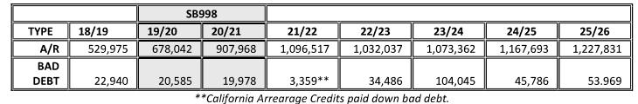
Overall assessment
Write-offs are primarily driven by final bill balances after service termination.
Key driver
Unpaid final bills after customers terminate service, especially before balances reach the internal lien threshold.
Historical comparison table, page 20
What appears to be working
Current owner balances remain low because property liens and other collection tools preserve recovery opportunities.
Opportunity
Continue final bill notifications and proactive collection outreach to reduce future write-offs.
Agenda Item 7B • Bad Debt Write-Off • 7
Notes:
Sources
Agenda 08-19-26.pdf, Agenda Item 7B: Staff Report and Bad Debt Write-Off analysis, pages 18-20.
Speaker notes
Use the historical table carefully: 2023/24 was notably higher. The immediate Board action is for the 2025/26 write-off, while the staff assessment points to final bill communication as the best operational improvement opportunity.

Slide 8
Recommended Board action
Approve the audit-required write-off and preserve ongoing collection remedies where available.
Approve the 2025/26 Bad Debt Write-Off
Amount: $53,968.56
Fiscal impact: bad debt expense recorded for FY 2025/26, equal to 88% of the $61,000 budget.
Accounting treatment only; does not necessarily terminate the District’s right to collect if collection remedies remain available.
88% of budget
Approve
Record expense
Continue remedies as available
Agenda Item 7B • Bad Debt Write-Off • 8
Notes:
Sources
Agenda 08-19-26.pdf, Agenda Item 7B: Staff Report and Bad Debt Write-Off analysis, pages 18-20.
Speaker notes
Close by restating the precise motion: approve the audit-required write-off of $53,968.56 for FY 2025/26 bad debt.

