Slide 1

BOARD MEETING
Agenda Items
7A–7D
7A
7B
7C
Staff recommendations
7D
September 2, 2026
Joshua Basin Water District
Notes:
Introduce the four agenda items and the decisions requested of the Board.
[Sources]
Joshua Basin Water District, Revised Agenda, September 2, 2026, Agenda Items 7A-7D (pp. 38-54).

Slide 2
MEETING OVERVIEW
7A–7D
Four items; three distinct Board actions
ITEM
SUBJECT
BOARD ACTION
IMPACT
7A
Lovemore Ranch plan check
Receive update
Informational
7B
Lovemore Ranch County letter
Approve / direct
Policy direction
7C
E2-1 construction management
Authorize
Up to $39,624
7D
Trailer-mounted arrow board
Authorize
$6,177 purchase
JOSHUA BASIN WATER DISTRICT | SEPTEMBER 2, 2026
02
Notes:
Frame 7A as information, 7B as direction on a County comment, and 7C-7D as spending authorizations.
[Sources]
Joshua Basin Water District, Revised Agenda, September 2, 2026, Agenda Items 7A-7D (pp. 38-54).

Slide 3
AGENDA ITEM
7A
Lovemore Ranch — JBWD Water and Wastewater Plan Check Status
RECEIVE INFORMATIONAL UPDATE
SEPTEMBER 2, 2026
Notes:
Begin the separate discussion of Agenda Item 7A.
[Sources]
Joshua Basin Water District, Revised Agenda, September 2, 2026, Agenda Items 7A-7D (pp. 38-54).

Slide 4
JURISDICTIONAL BOUNDARY
7A
JBWD’s role is service feasibility—not land-use approval
JBWD decides
The land-use agency decides
Can water and wastewater service feasibly be provided?
Whether the development should be approved or denied.
What facilities, conditions, safeguards and financial assurances are required?
Land-use entitlements, density and project permitting.
Whether technical studies satisfy District Rules & Regulations.
Adequacy of the County’s environmental review.
Plan check is neither endorsement nor opposition to the development.
JOSHUA BASIN WATER DISTRICT | SEPTEMBER 2, 2026
04
Notes:
Emphasize that JBWD is not a land-use agency. Its technical review is required for service feasibility and should not be characterized as approval or disapproval of the project.
[Sources]
Joshua Basin Water District, Revised Agenda, September 2, 2026, Agenda Items 7A-7D (pp. 38-54).

Slide 5
LOVEMORE RANCH PLAN CHECK STATUS
7A
Both feasibility studies are ongoing
WATER STUDY
WASTEWATER STUDY
Revision 2 under review
Revised study not submitted
West Coast Civil is reviewing the Developer’s revised study. Further comments or revisions may be required.
The initial study received substantial comments, including long-term ownership, operations, compliance, funding, emergency response, oversight and groundwater protection.
Next milestone: completed technical review → Board consideration under District Rules & Regulations
JOSHUA BASIN WATER DISTRICT | SEPTEMBER 2, 2026
05
Notes:
Neither study has completed District review, and neither has been presented to the Board for final review and acceptance. Plan-check costs are funded by the Developer’s deposit.
[Sources]
Joshua Basin Water District, Revised Agenda, September 2, 2026, Agenda Items 7A-7D (pp. 38-54).

Slide 6
DETAILED PLAN CHECK STATUS
7A
Water and wastewater reviews are at different stages
Water study
Second revision submitted → West Coast Civil review underway → additional comments or revisions may follow
Wastewater study
Initial review completed → substantial information requested → revised study has not been submitted
The wastewater plan check must establish a durable operating framework
Ownership and governance
Operation and maintenance
Regulatory compliance
Repair and replacement
Financial assurances and funding
Emergency response
District access and oversight
Groundwater protection
Public status: review is ongoing; neither study is complete or ready for Board acceptance.
JOSHUA BASIN WATER DISTRICT | SEPTEMBER 2, 2026
06
Notes:
The wastewater facilities are expected to remain in service for the life of the development and are not currently proposed to be owned or operated by JBWD.
Plan-check costs are funded from the Developer's plan-check deposit.
[Sources]
Joshua Basin Water District, Revised Agenda, September 2, 2026, Agenda Items 7A-7D (pp. 38-54).

Slide 7
AGENDA ITEM
7B
Lovemore Ranch — Comment Letter to San Bernardino County
CONSIDER APPROVAL AND AUTHORIZE SUBMISSION
SEPTEMBER 2, 2026
Notes:
Begin the separate discussion of Agenda Item 7B.
[Sources]
Joshua Basin Water District, Revised Agenda, September 2, 2026, Agenda Items 7A-7D (pp. 38-54).

Slide 8
WHY COMMENT NOW?
7B
The County comment letter and JBWD plan check are separate tracks
COUNTY CEQA COMMENT
JBWD SERVICE REVIEW
Focused input
Feasibility determination
≠
Hydrology and drainage
Technical requirements
Groundwater and recharge
Facilities and conditions
On-site wastewater facility
Long-term service protections
Commenting protects JBWD’s responsible-agency interests;
it does not decide the project’s land-use merits or pre-approve service.
JOSHUA BASIN WATER DISTRICT | SEPTEMBER 2, 2026
08
Notes:
The proposed letter is limited to matters within JBWD’s expertise and jurisdiction. JBWD may later rely on the County’s environmental document when acting on its own approvals.
[Sources]
Joshua Basin Water District, Revised Agenda, September 2, 2026, Agenda Items 7A-7D (pp. 38-54).

Slide 9
REQUESTED COUNTY ANALYSIS
7B
The draft letter asks the County to resolve three technical questions - For the Record
01
Can Lot A fit both systems?
Demonstrate that the 0.52-acre lot can accommodate a compliant detention system and an operable wastewater treatment facility.
02
How do stormwater and effluent interact?
Present RWQCB-informed analysis of detention, infiltration, treated-effluent disposal and groundwater quality.
03
What changes for groundwater recharge?
Clarify whether the redesigned basin or basin-and-pipe system changes infiltration and recharge to the Joshua Tree subbasin.
Proposed motion: approve the letter and authorize GM Pro Tem submission, with counsel-approved non-substantive revisions.
JOSHUA BASIN WATER DISTRICT | SEPTEMBER 2, 2026
09
Notes:
The letter expressly takes no position on density or other land-use merits and reserves all rights regarding ownership or operation of the wastewater facility.
[Sources]
Joshua Basin Water District, Revised Agenda, September 2, 2026, Agenda Items 7A-7D (pp. 38-54).

Slide 10
AGENDA ITEM
7C
E2-1 Reservoir Rehabilitation — Additional Ardurra Services
CONSIDER AUTHORIZATION OF ADDITIONAL SERVICES
SEPTEMBER 2, 2026
Notes:
Begin the separate discussion of Agenda Item 7C.
[Sources]
Joshua Basin Water District, Revised Agenda, September 2, 2026, Agenda Items 7A-7D (pp. 38-54).

Slide 11
NEED FOR ADDITIONAL SERVICES
7C
Interim construction management keeps the active E2-1 reservoir project moving
WHY NOW
WHAT ARDURRA ADDS
Progress meetings and document control
Time-sensitive gap
The transition to an anticipated in-house project/construction manager was delayed while construction progressed. Ardurra already knows the project, avoiding delay and duplicated onboarding.
Coordination, RFIs and submittals
Change orders and payment review
Field visits, punch list and closeout
Services are requested only as needed and billed on time-and-materials up to the authorized ceiling.
JOSHUA BASIN WATER DISTRICT | SEPTEMBER 2, 2026
11
Notes:
The added work is outside the existing Engineering Services During Construction scope but relates to the same active project.
[Sources]
Joshua Basin Water District, Revised Agenda, September 2, 2026, Agenda Items 7A-7D (pp. 38-54).

Slide 12
CONTRACT AND BUDGET IMPACT
7C
Ardurra authorization rises to $131,313;
no overall budget increase is anticipated
$91,689
$39,624
$131,313
+
=
existing agreement
additional NTE
total authorization
$871,000
Project A22203 combined FY 2025/26 + FY 2026/27 budget
Budget is expected to be sufficient; a timing adjustment or transfer between accounts may still be needed.
JOSHUA BASIN WATER DISTRICT | SEPTEMBER 2, 2026
12
Notes:
Staff expects the actual need may be less than the full proposal amount. Prior-year unexpended amounts may also represent potential budget authority that could be carried forward.
[Sources]
Joshua Basin Water District, Revised Agenda, September 2, 2026, Agenda Items 7A-7D (pp. 38-54).

Slide 13
AGENDA ITEM
7D
Trailer-Mounted Arrow Board
CONSIDER PURCHASE AUTHORIZATION
SEPTEMBER 2, 2026
Notes:
Begin the separate discussion of Agenda Item 7D.
[Sources]
Joshua Basin Water District, Revised Agenda, September 2, 2026, Agenda Items 7A-7D (pp. 38-54).

Slide 14
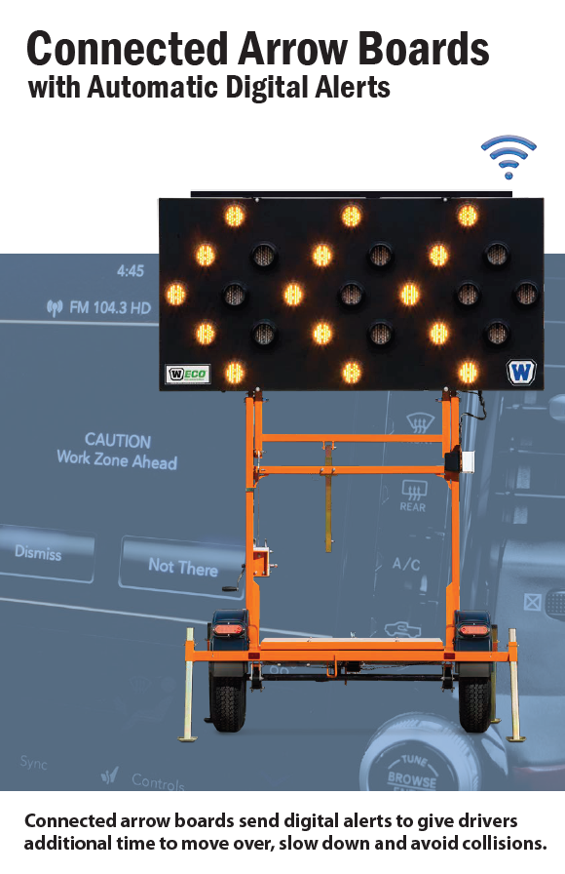
FIELD SAFETY PURCHASE
7D
A trailer-mounted arrow board adds advance warning for roadway work
Current gap
Earlier merging and fewer vehicle intrusions
JBWD does not currently own a trailer-mounted arrow board for lane closures or work near moving traffic.
Clearer lane closures and shifts
Night, low-light and adverse-weather visibility
Planned and emergency work both require clear, visible direction for motorists.
Flexible use across maintenance and construction
WANCO 55/W Solar 25 LED | $6,177
JOSHUA BASIN WATER DISTRICT | SEPTEMBER 2, 2026
14
Notes:
The FY 2026/27 budget includes $10,000 for a trailer-mounted arrow board. The staff report recommends purchase from Tops N Barricades.
[Sources]
Joshua Basin Water District, Revised Agenda, September 2, 2026, Agenda Items 7A-7D (pp. 38-54).

Slide 15
RECOMMENDED ACTIONS
7A–7D
Board direction requested
7A
Receive
Plan check status update
7B
Approve / direct
County comment letter and authorization to submit
7C
Authorize
Up to $39,624 in added Ardurra services
7D
Authorize
$6,177 trailer-mounted arrow board purchase
JOSHUA BASIN WATER DISTRICT | SEPTEMBER 2, 2026
15
Notes:
Close by restating the requested action for each item and invite Board questions.
[Sources]
Joshua Basin Water District, Revised Agenda, September 2, 2026, Agenda Items 7A-7D (pp. 38-54).

