Slide 1

Cr-6 Outreach Assistance for Joshua Basin Water District
Joshua Basin Water District Board Meeting
March 19th, 2026
Notes:
Austin

Slide 2
Agenda
Introductions to the Alliance team supporting JBWD
Overview of our assistance to JBWD to date
Overview of current work, including:
  Cr-6 FAQs
  Cr-6 flyer & poster

Slide 3
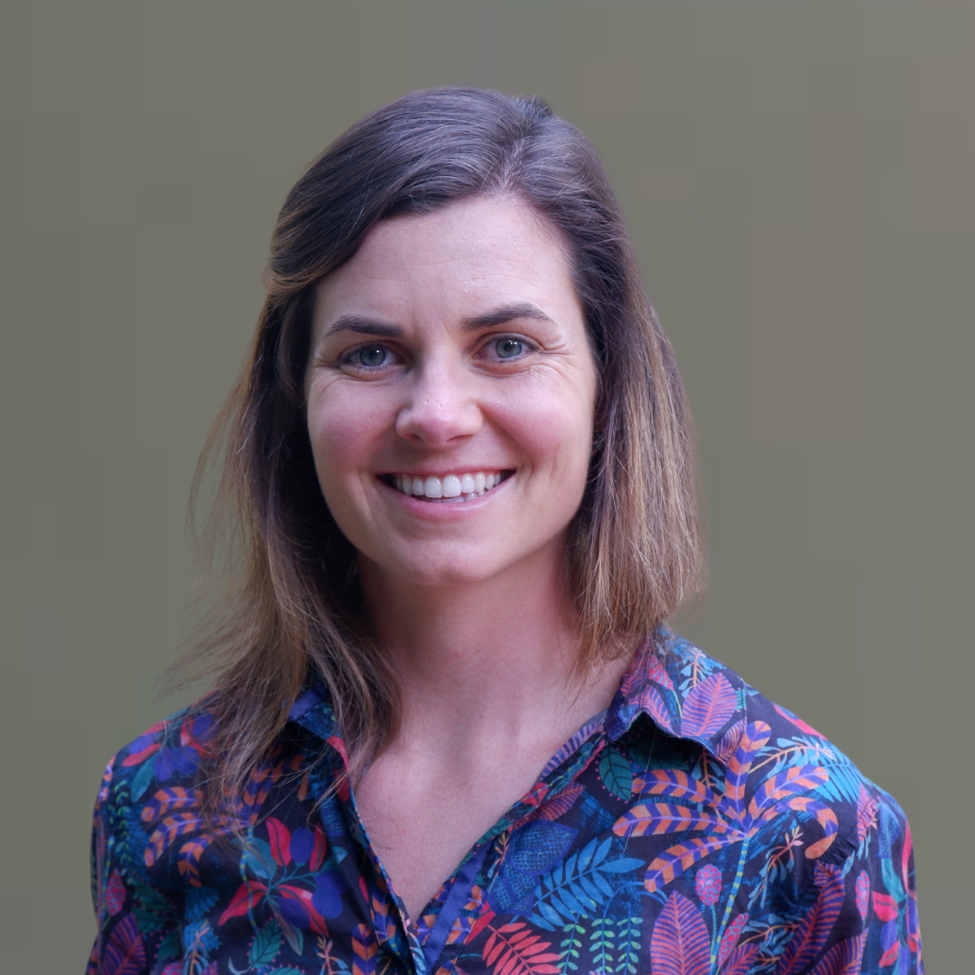
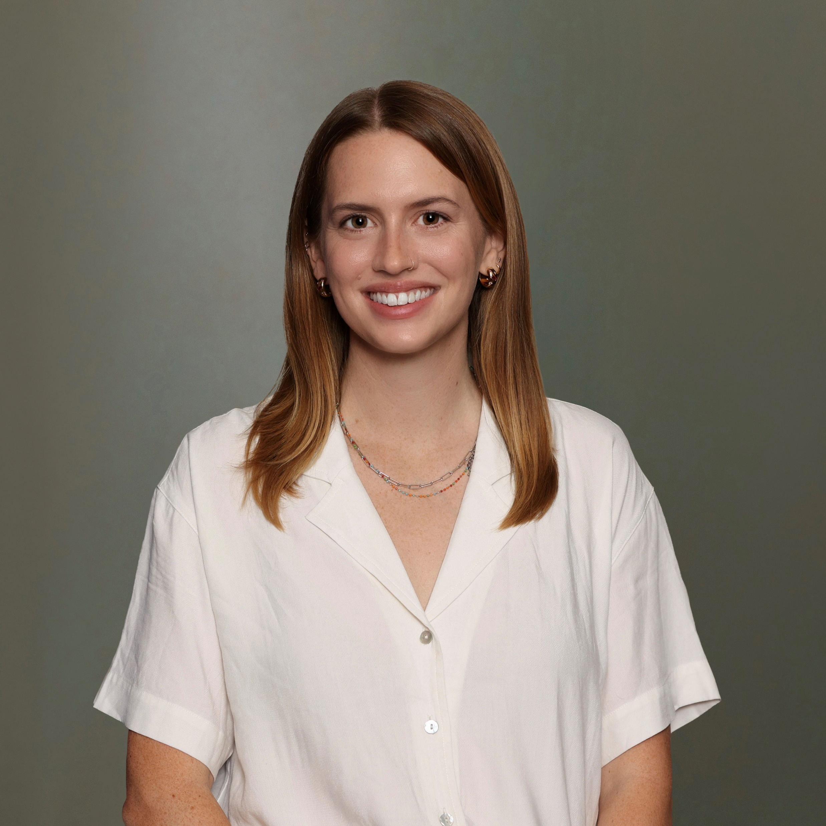
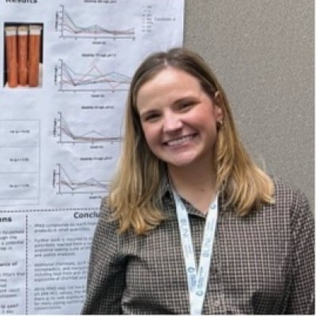
The Alliance Team Supporting Joshua Basin Water District
Austin Thompson-Spain
US Water Alliance
Carrie Smith
US Water Alliance
Kathleen Hohweiler
Virginia Tech
(PhD Research Assistant w/ US Water Alliance)

Slide 4
The Alliance’s Work with Joshua Basin Water District
Completed
In Progress
Financial: Financial Health Assessment; Grant Requirements Support
Technical: Chromium-6 Alternatives Analysis
Outreach: Cr-6 FAQs for JBWD’s Website
Financial: Funding/Financing Inventories
Outreach: Community Visit and Tabling
Outreach: Cr-6 Flyer and Poster for Farmer’s Market, District Tours, etc.
Notes:
Austin
Financial health assessment:
Conducted a review of key financial indicators for the District to assess readiness to apply for external funding. Found that the District’s finances are trending in the right direction, in large part due to the intentionality of the district with regard to infrastructure replacement, rate-setting, and pursuing external funding.
Grant Requirements Support
Helped the District understand the funding cycle for LSL-related needs. Identified the possibility of retroactively applying for funding for LSL inventories.
Chromium-6 Alternatives Analysis
Developed a scope of work, shared that scope of work with our subconsultants.
Funding/Financing Inventories
Developing inventories for LSL and Chromium-6-related funding and financing resources
Grant application review
Work w/ partner to provide support to JBWD as the District develops applications for state grants
Community visit
- Get to know the community, potentially support with messaging around regulatory changes

Slide 5
Cr-6 Outreach Materials & Associated Goals
Material: FAQs
Goal: Provide the District with a comprehensive list of questions (and answers) for the website and interactions with the public.
Material(s): Flyer & poster
Goal: Provide the District with materials to hand out to the public (flyer) or have on display (poster) at the Farmer’s Market, District tours, and other events.
Material: Graphics (2)
Goal: Provide the District with a visual representation of complicated and/or unfamiliar concepts that can be used on the website, in presentations, etc.

Slide 6
Overview of Cr-6 FAQs
The US Water Alliance worked with JBWD staff to develop Cr-6 FAQs.
These FAQs are based on questions staff are hearing or expect to hear from customers.
The FAQs cover three categories of questions:
    Background information
    The District’s response to date
    The District’s plan going forward
This presentation lists the questions we identified.

Slide 7
Cr-6 FAQs: Background
Why am I receiving Chromium-6 notices from the District with my water bill?
What is Chromium? Where does it come from?
Who regulates Chromium-6 (Cr-6)?
What is a Maximum Contaminant Level (MCL)?

Slide 8
Cr-6 FAQs: Background
How have Chromium regulations changed?
Which of the two MCLs (i.e., EPAs or California’s) does the District have to meet?
What is a part per billion? How do you measure that?
Why is California’s Chromium-6 MCL so much lower than the US EPA’s Total Chromium MCL?
Why did the Chromium-6 regulations change in the first place?

Slide 9
Cr-6 FAQs: Background
What is a Public Health Goal?
If my drinking water has Chromium-6 above the new MCL, is my water safe to drink?
I also have a groundwater well on my property. Is my water safe to drink?
How many water districts are affected by these new regulations?

Slide 10
Cr-6 FAQs: District Response
Has the District tested for Chromium-6? What were the results of these tests?
Is the District out of compliance with state regulations?
What has the District done so far to respond to these changes?

Slide 11
Cr-6 FAQs: The District’s Plan
What happens if the District does not comply with state regulations?
What is the District’s plan going forward?

Slide 12
Cr-6 Flyer and Poster
The US Water Alliance worked with a creative consultant and JBWD staff to develop a Cr-6 flyer and poster.
The flyer and poster share the same copy and are based on the FAQs and the District’s Cr-6 talking points.
The materials are designed to be easy to understand, visually appealing, and to direct customers to JBWD’s website.

Slide 13
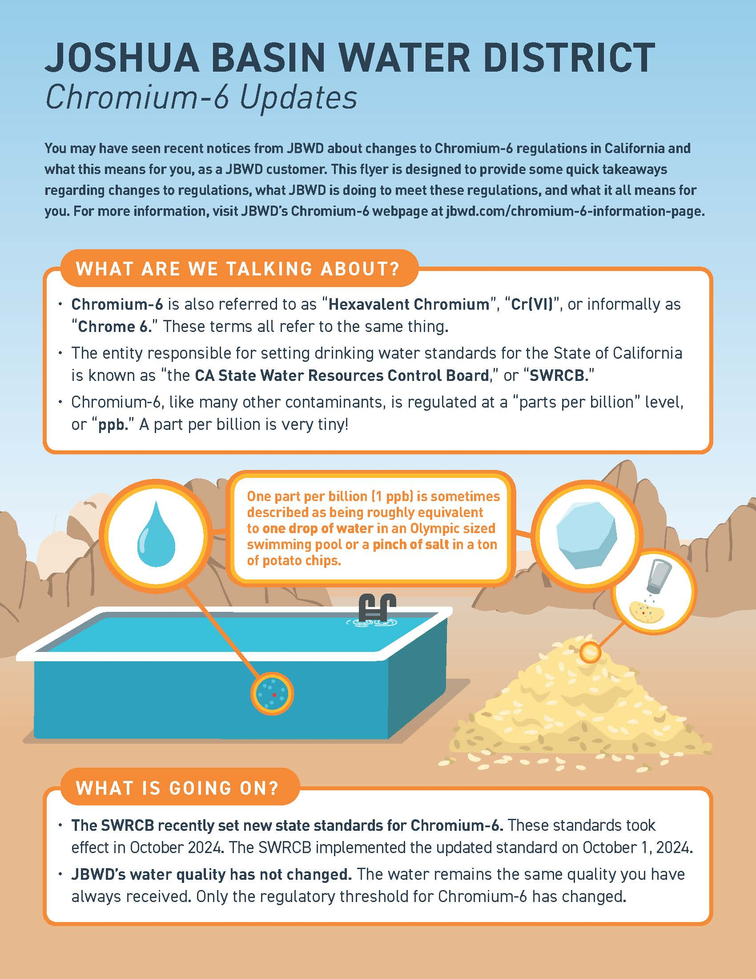
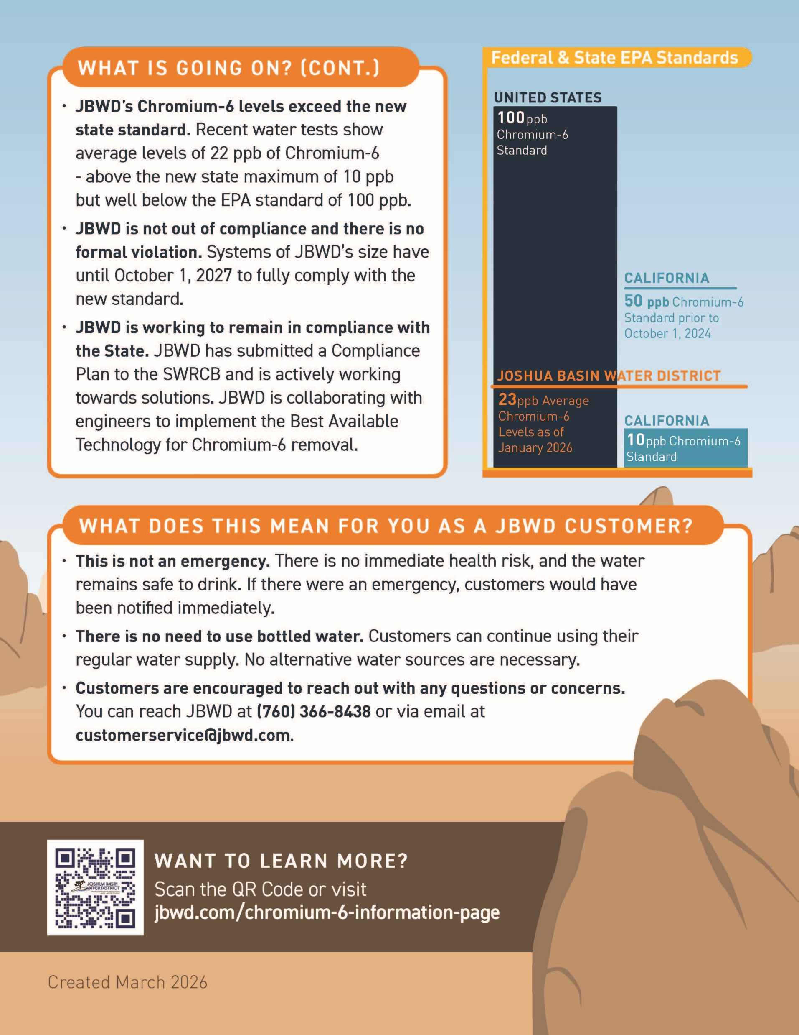
Cr-6 Flyer

Slide 14
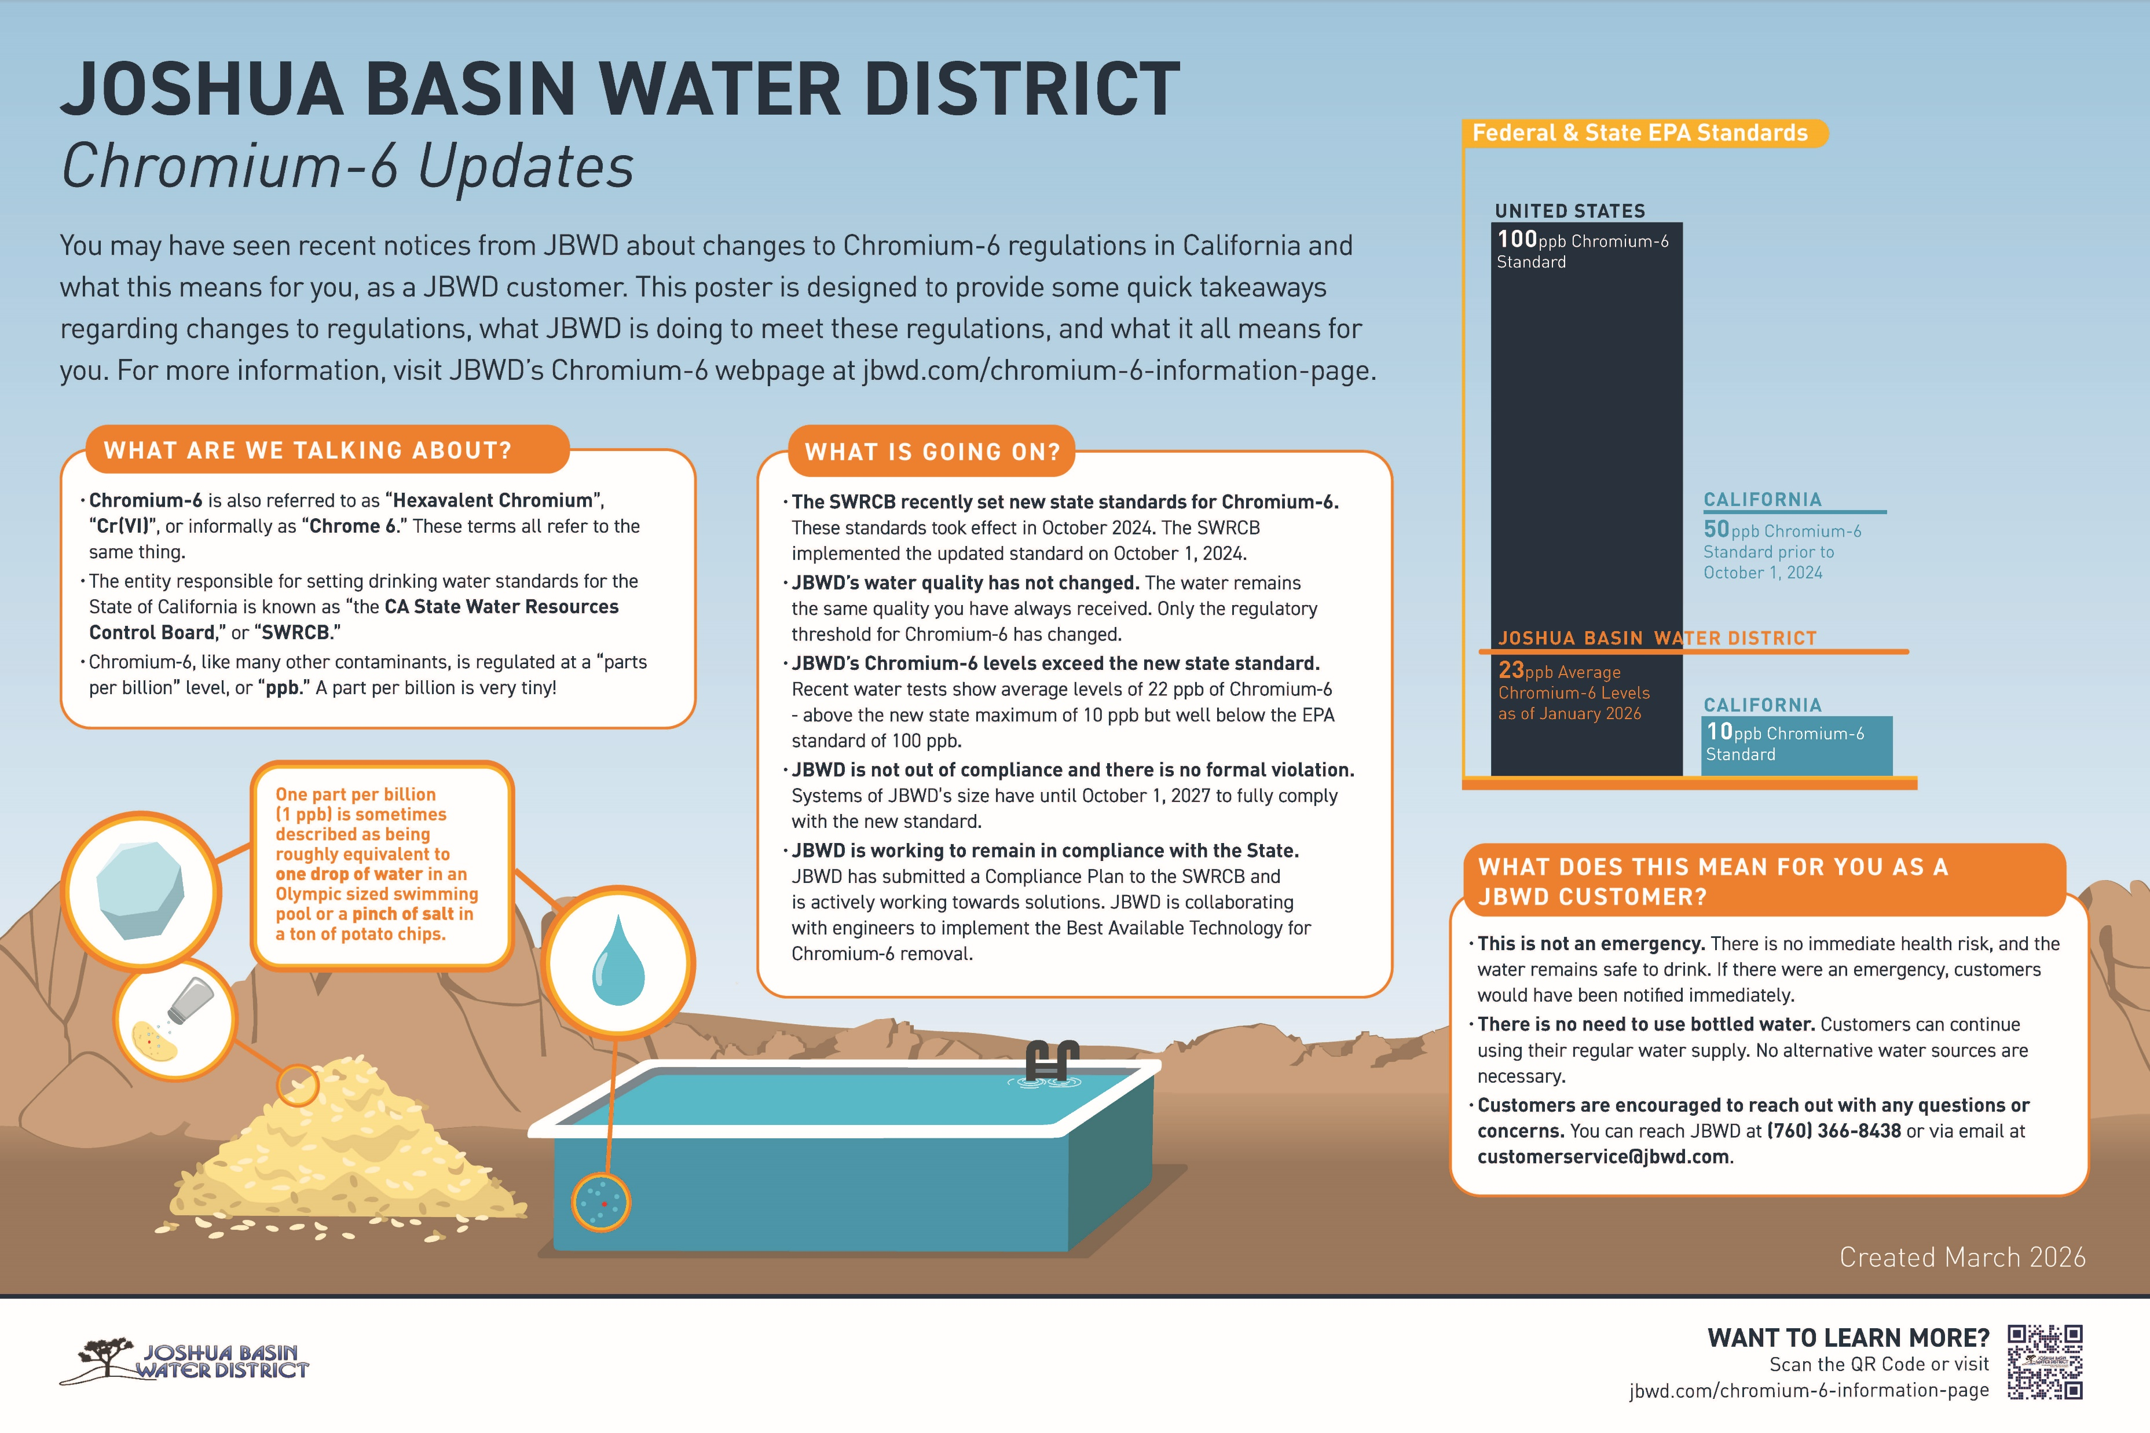
Cr-6 Poster

Slide 15
Thank you!
Carrie Smith
csmith@uswateralliance.org
Austin Thompson-Spain
athompsonspain@uswateralliance.org

