Slide 1

Reserve Fund Policy Update
Joshua Basin Water District
December 8, 2025

Slide 2
UNRESTRICTED (DESIGNATED VS. RESTRICTD
The Reserves discussed are Unrestricted (Board-Designated) and, just as these requirements are set by the Board, they can be changed at any time by Board action.
Legally restricted reserves have minimal recommended changes so discussion is limited due to the compulsory nature of those reserves.

Slide 3
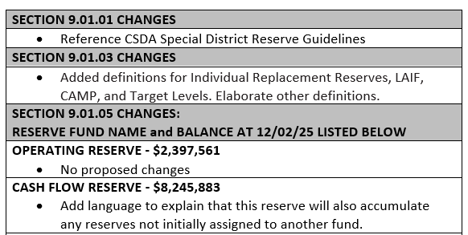
SUBSTANTIVE CHANGES, PT 1
Page 10

Slide 4
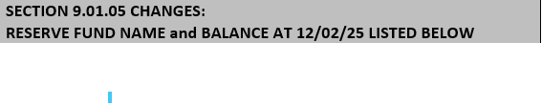
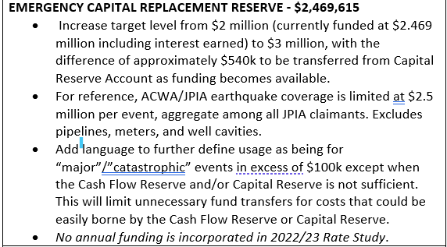
SUBSTANTIVE CHANGES, PT 2
Page 10-11

Slide 5
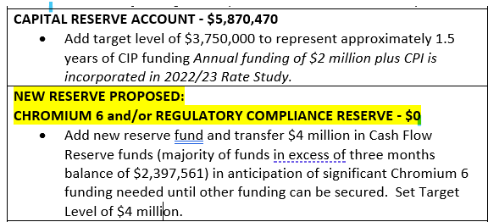
OPTIONS
SUBSTANTIVE CHANGES, PT 3
Page 11

Slide 6
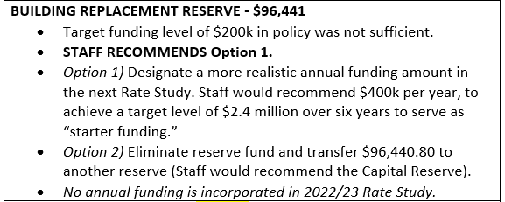
OPTIONS
SUBSTANTIVE CHANGES, PT 4
Page 11

Slide 7
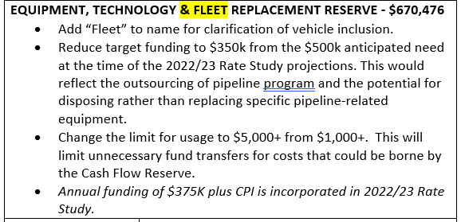
Also added language for using for controlled fleet expansion of up to 15%.
SUBSTANTIVE CHANGES, PT 5
Page 11

Slide 8
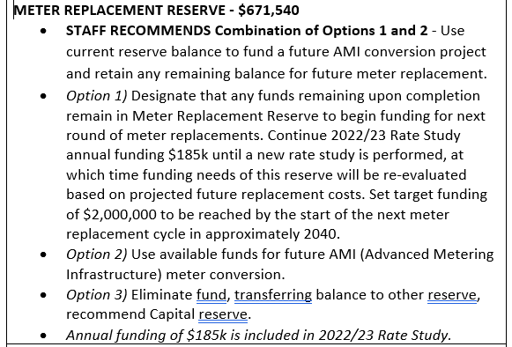
OPTIONS
SUBSTANTIVE CHANGES, PT 6
Page 11-12

Slide 9
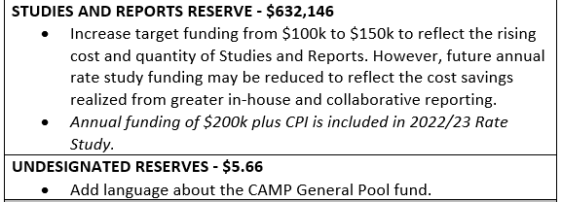
SUBSTANTIVE CHANGES, PT 7
Page 12

Slide 10
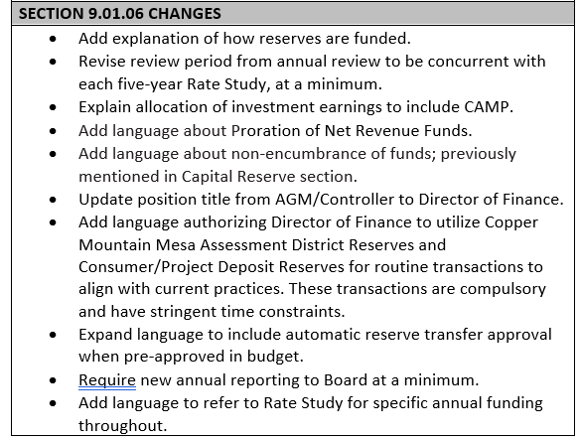
SUBSTANTIVE CHANGES, PT 8
Page 12

Slide 11
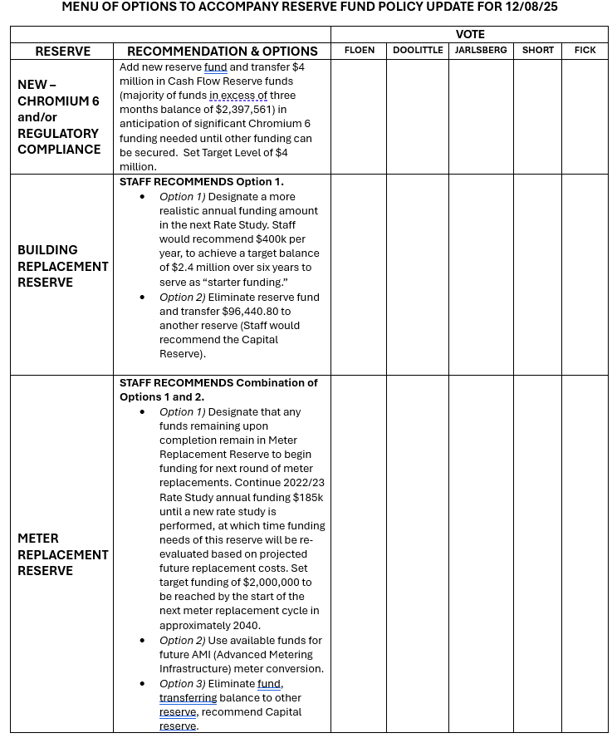
“MENU” OF OPTIONS

Slide 12
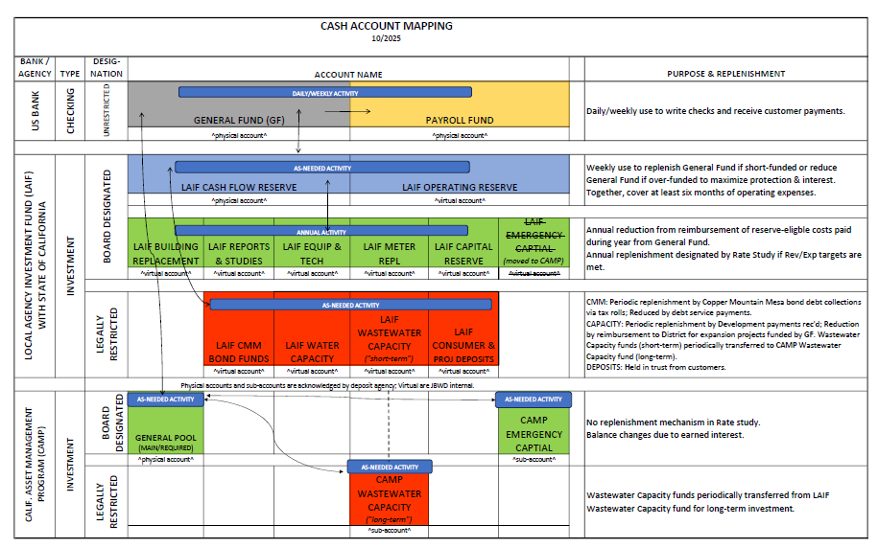

Slide 13
FISCAL IMPACT:
Proposed transfers among Reserve funds resulting from these changes will have no overall fiscal impact on the District.

Slide 14
RECOMMENDED ACTION:
Review, provide recommendations, and approve revisions to Article 9 of the Administration Code, as detailed in Resolution No. 25-1081 Exhibit A.

Slide 15

QUESTIONS?

