Slide 1

TYLER EXCELLENCE AWARDS 2026
OPERATIONAL EFFICIENCY HONORABLE MENTION

Slide 2
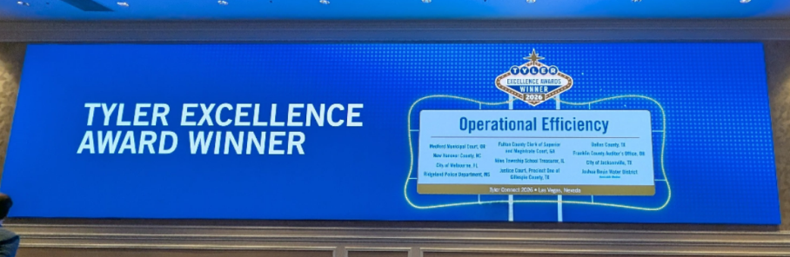

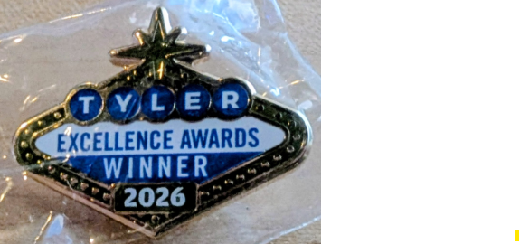

Slide 3



