Slide 1


Customer support staff report. january – June 2026.
David shook
Director of administration

Slide 2
This presentation will cover customer support statistics from jan 1 – June 30, 2026.
Similar application processing to the second half of 2025. We processed 370 water service applications.
This averages 61 per month.
In the second half of 2025, we processed 371 applications.

Slide 3


Phone calls remain the top communication method with customers.
January through June 2026, Customer Support fielded 6,830 phone calls.
Many of these were transferred to the online Paymentus portal.
Our Customer Support Specialists spent 336 hours on the phone during this timeframe.

Slide 4

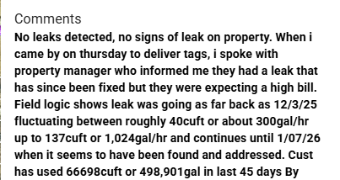
Higher than “normal” use letters
January through June 2026, we sent out 182 higher than average use letters.
Most of these letters were for notices between 10 and 20 units.
The highest was a notice for 627 units.

Slide 5
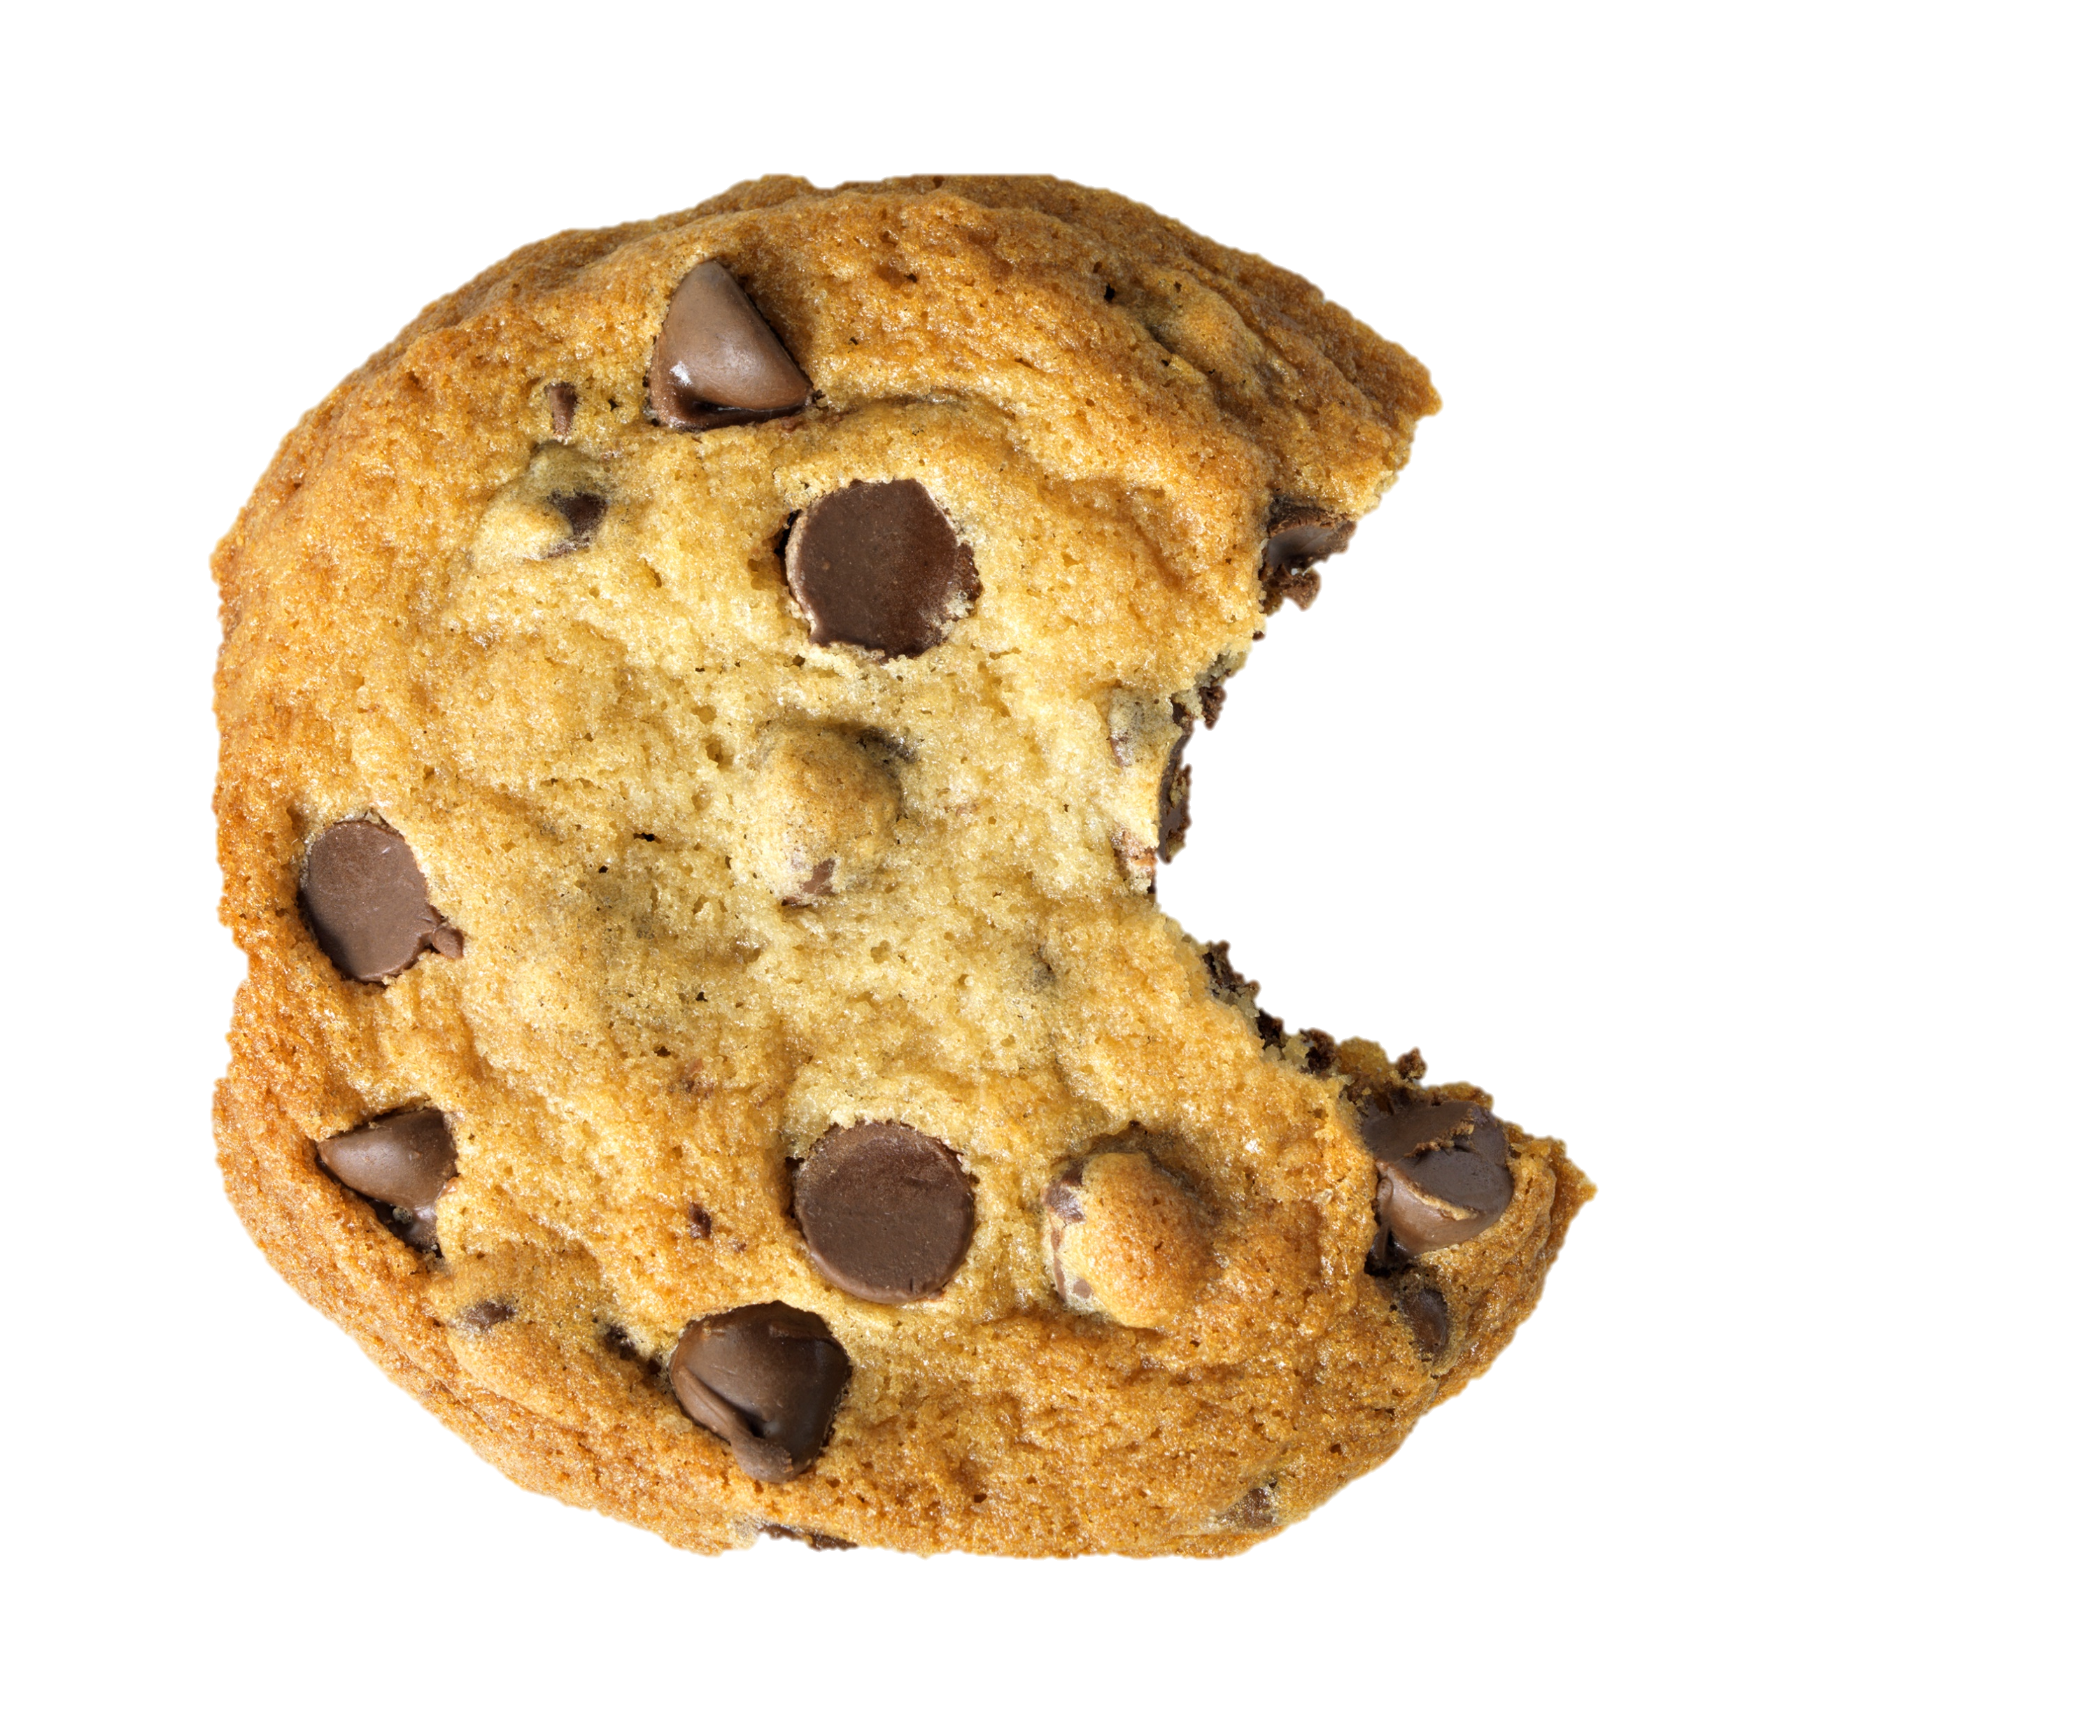
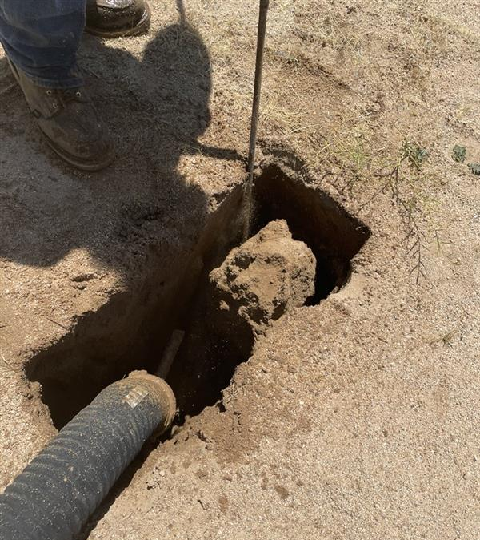
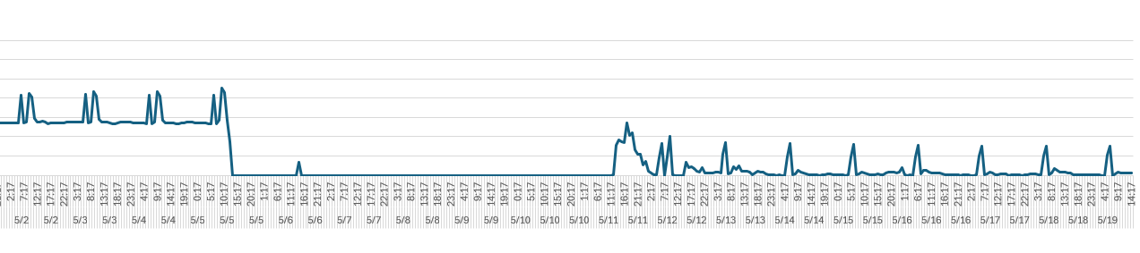
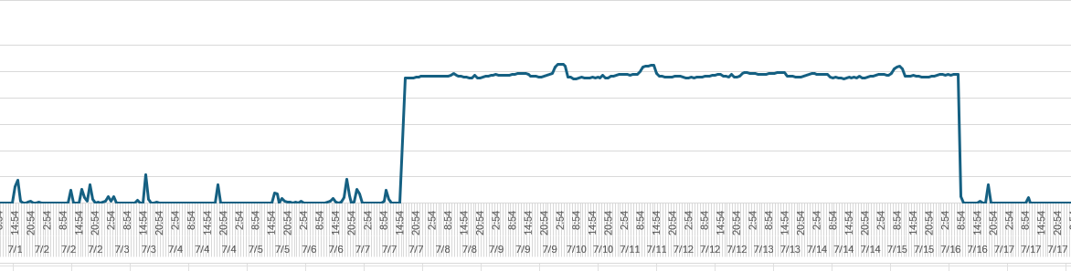
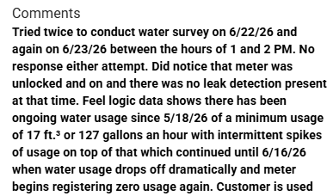
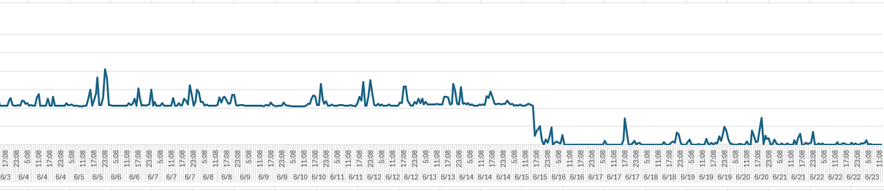
Work with the field
Field Logic Data Log Devices
  These devices have been invaluable tools by providing data to supply to our customers.
    We extract the data from the meters and assign that data to a graph, which provides a visual.
Irrigation
Tenant(s) Evicted
Customer Found & Fixed Issue

Slide 6
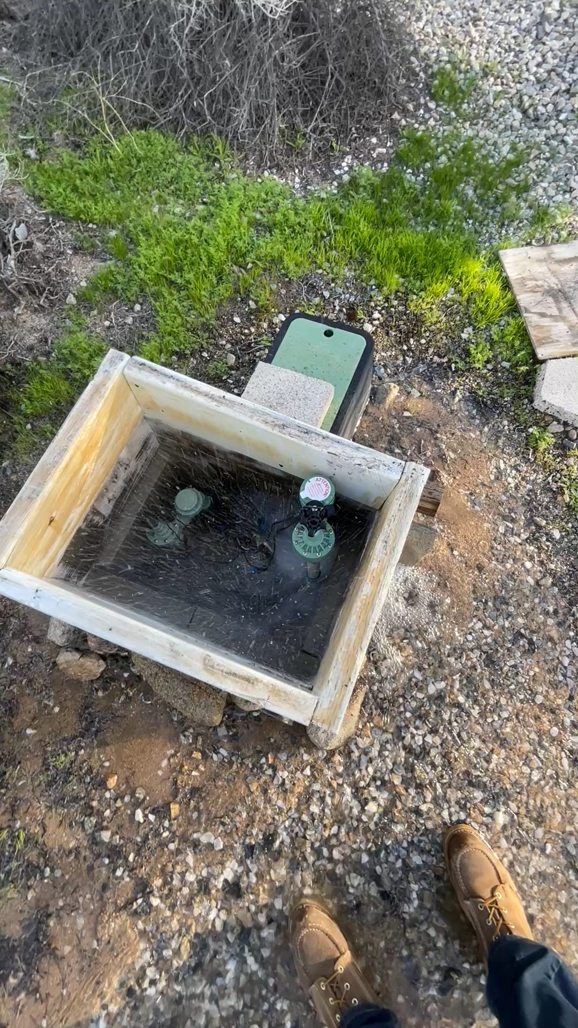

Slide 7
Common findings
There is a recurring theme of irrigation programming issues and/or manually watering, leaving hoses on.
In 2026, we have not had ANY customer requests for meter testing.
  I believe this is directly impacted by the Field Logic data that we are able to pull and provide to our customers.

Slide 8

Thank you to staff for their input, dedication, and resilience.
This Photo by Unknown Author is licensed under CC BY-SA-NC

