Slide 1
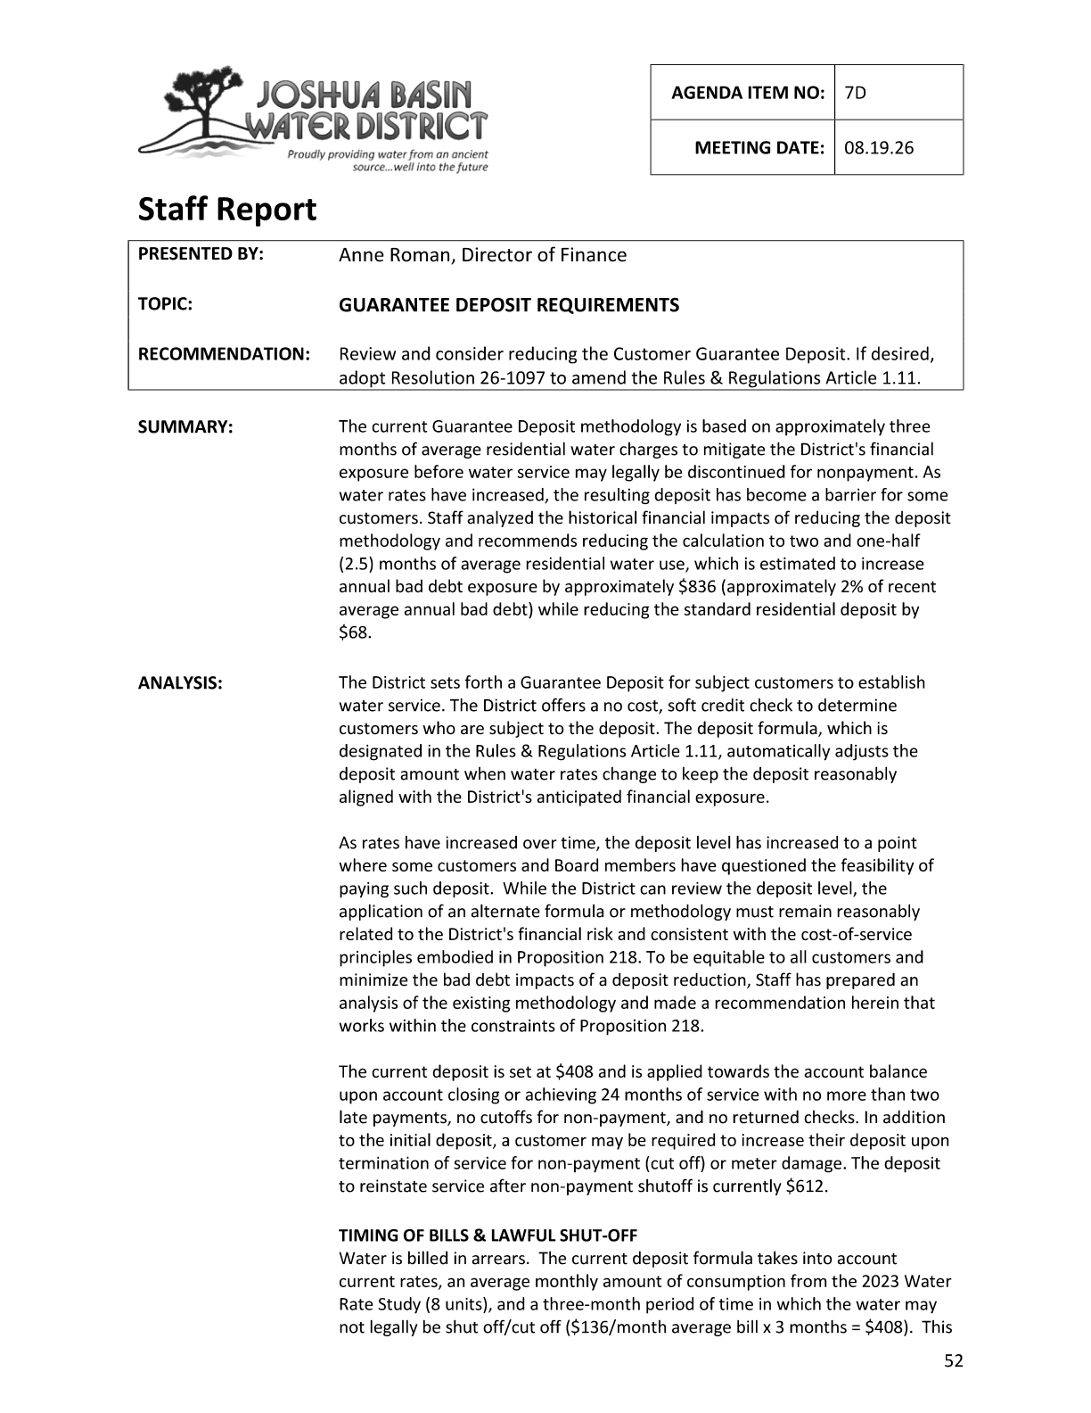
JOSHUA BASIN WATER DISTRICT
Guarantee Deposit
Requirements
Board presentation • Agenda Item 7D • August 19, 2026
Notes:
[Sources]
Agenda packet pages 52-58, Item 7D: Guarantee Deposit Requirements staff report, Resolution No. 26-1097, and proposed Rules & Regulations Article 1.11 amendment. Page 54 includes the current and proposed standard deposit amounts.

Slide 2
RECOMMENDED ACTION
Why this item is before the Board
Review and consider reducing the Customer Guarantee Deposit. If desired, adopt Resolution No. 26-1097 to amend Rules & Regulations Article 1.11.
1
2
3
3
When rates change
Deposit recalculated
Board may amend
Staff recommends a modest reduction
while maintaining reasonable financial protection for the District.
Source: Agenda packet, Item 7D staff report, p. 52.
Notes:
[Sources]
Agenda packet page 52 identifies Agenda Item 7D, the recommendation to review and consider reducing the Customer Guarantee Deposit, and the option to adopt Resolution 26-1097 to amend Rules & Regulations Article 1.11. Page 52 also describes the current methodology and staff recommendation.

Slide 3
JOSHUA BASIN WATER DISTRICT
Guarantee Deposit
Current vs. Proposed
$408
$340
current standard deposit
proposed standard deposit
The above is based on current rates. This change is proposed to become effective January 2027. Based on pre-approved rates, the guarantee deposit would be $369 (vs. $443) beginning in January 2027.
Notes:
[Sources]
Agenda packet pages 52-58, Item 7D: Guarantee Deposit Requirements staff report, Resolution No. 26-1097, and proposed Rules & Regulations Article 1.11 amendment. Page 54 includes the current and proposed standard deposit amounts.

Slide 4
AFFORDABILITY + RISK PROTECTION
The policy balance
Guarantee Deposits help secure payment for water charges, but the upfront amount should be reasonably related to the District’s financial exposure.
Customer affordability
District protection
Lower upfront cost
Maintain payment security
Core idea: Reduce an upfront burden without materially increasing bad debt risk.
Source: Agenda packet, Item 7D staff report, pp. 52-55.
Notes:
[Sources]
Agenda packet pages 52-55 discuss the current deposit methodology, financial exposure rationale, customer affordability, and fiscal impact of the proposed reduction.

Slide 5
DEPOSIT METHODOLOGY
Proposed change to standard deposit
Staff recommends changing the standard Guarantee Deposit from 3.0 months to 2.5 months of average residential water use.
Deposit formula
Current
$408
3.0 months
Current: Average of 8 units of water per most recent Rate Study x 3 months.
Proposed: Average of 8 units of water per most recent Rate Study x 2.5 months
Proposed
$340
2.5 months
$68
less upfront
The proposed standard deposit remains tied to the most recent Water Rate Study and continues to adjust when rates are changed.
Source: Agenda packet, Item 7D analysis and recommendation, p. 54.
Notes:
[Sources]
Agenda packet page 54 shows the proposed change from 3 months to 2.5 months, the current $408 standard deposit, the proposed $340 standard deposit, and the $68 (16.7%) reduction. Page 57 states that the Guarantee Deposit is based on the most recent water rate study and re-calculated when water rates change.

Slide 6
RISK SAFEGUARDS
Deposit tools remain available
The standard deposit drops, but Article 1.11 continues to preserve higher deposits for higher-risk account situations.
1
2
3
Standard
Reinstatement
Damage/Lock
$340
$510
$680
2.5 months
1.5× standard
up to 2× standard
Graphic assumes the proposed $340 standard deposit.
Special deposits remain governed by Article 1.11 and account circumstances
and bear a reasonable relationship to anticipated financial exposure.
Source: Proposed Rules & Regulations Article 1.11, pp. 57-58.
Notes:
[Sources]
Agenda packet pages 57-58 describe the revised Guarantee Deposit, Termination of Water Service Deposit equal to one and one-half times the Guarantee Deposit, Damage/Lock Deposit up to two times the standard deposit, and Continuous Service Agreement Deposit.

Slide 7
RISK ANALYSIS
Financial impact is limited
Historical analysis estimates the proposed reduction would increase unsecured bad debt exposure by approximately $836 annually — about 2% of the District’s recent average annual bad debt experience.
$836
~2%
$68
estimated annual increase in unsecured exposure
share of recent average annual bad debt
customer deposit reduction per standard account
Conclusion: The reduction is expected to improve customer affordability
while preserving meaningful risk mitigation.
Source: Agenda packet, Item 7D fiscal impact, p. 55.
Notes:
[Sources]
Agenda packet page 55 states the proposed reduction would increase unsecured bad debt exposure by approximately $836 annually, about 2% of the District’s recent average annual bad debt experience. Page 54 also states the reduction from the current standard deposit is $68 (16.7%).

Slide 8
A/R AND BAD DEBT TREND
Historical context: bad debt remains manageable
The staff report compares A/R and bad debt and finds the proposed change would add a small amount of estimated exposure relative to recent experience.
Bad debt history
Modeled effect
$5397
$4168
$4579
~2%
$3446
$2200
$2059
$1317
$1397
of recent average
annual bad debt
18/19
19/20
20/21
21/22
22/23
23/24
24/25
25/26
Source: Agenda packet, A/R and bad debt history table and analysis, pp. 53-55.
Notes:
[Sources]
Agenda packet page 53 contains the A/R and bad debt history table. Agenda packet pages 54-55 contain staff analysis stating the proposed reduction would increase unsecured bad debt exposure by approximately $836 annually, about 2% of the District’s recent average annual bad debt experience.

Slide 9
RULES & REGULATIONS
Article 1.11 clarifies the customer path
The proposed amendment keeps deposits as a payment-security tool and clarifies standard deposits, refunds, reinstatement, damage/lock, and continuous-service deposits.
1
2
3
4
Apply
Good history
Refund
Special cases
deposit
before service
24 months; no >2 late payments
credit or check to customer
reinstatement / damage
Revised Article 1.11 = clearer operating rules
+ administrative consistency
Source: Proposed Rules & Regulations Article 1.11, pp. 57-58.
Notes:
[Sources]
Agenda packet pages 57-58 show the proposed Article 1.11 text, including deposit before service, refund criteria, the 1.5x termination/reinstatement deposit, the damage/lock deposit, and continuous-service agreement deposit provisions.

Slide 10
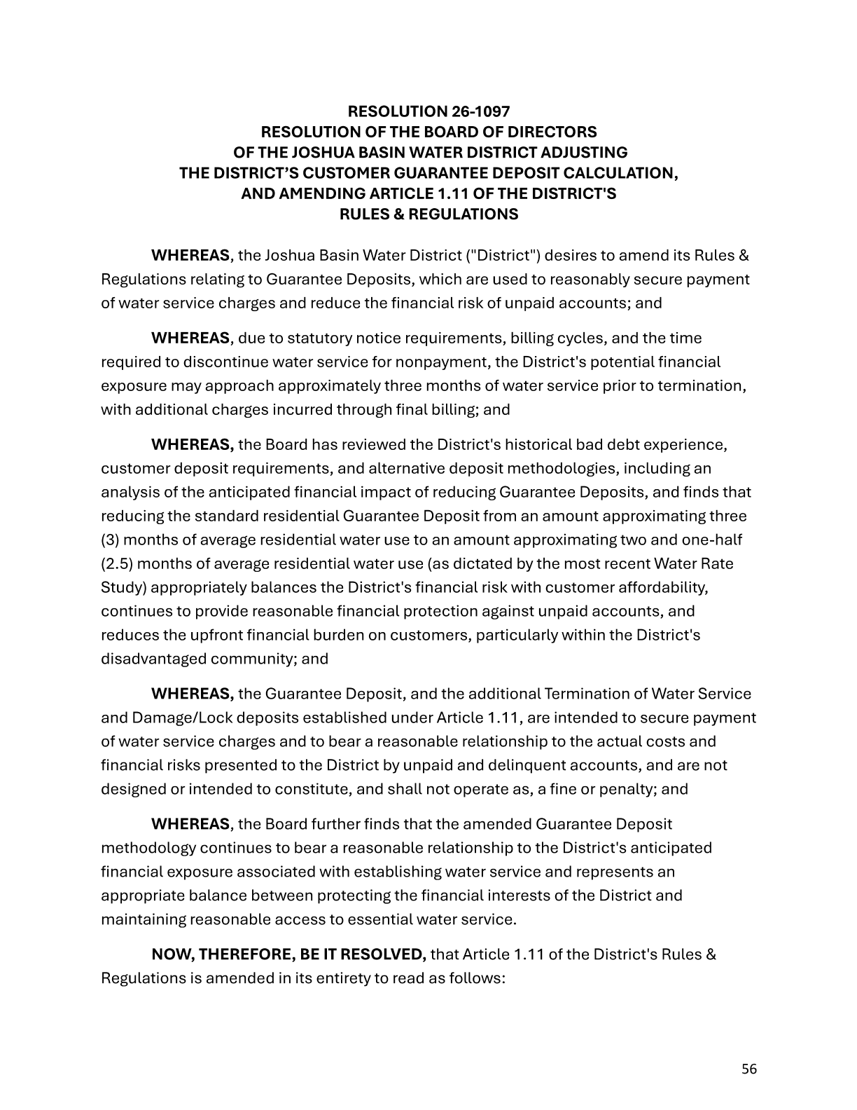
STAFF RECOMMENDATION
Implementation approach
Staff recommends a prospective rollout, with the formula tied to rates and staff handling administrative updates.
Now
After adoption
Jan. 2027
Ongoing
1
2
3
4
Board review
Admin updates
Prospective start
Formula refresh
Consider Resolution 26-1097
Revise forms and procedures
Apply new standard deposit
Update with rate changes
Source: Agenda packet recommendation and Resolution No. 26-1097, pp. 54 and 56.
Notes:
[Sources]
Agenda packet page 54 lists staff recommendations: keep the formula tied to rates, start the new deposit prospectively in January 2027, revise forms, and adopt Resolution 26-1097. Page 56 contains the resolution amending Article 1.11.

Slide 11
BOARD ACTION
Decision requested
Review the proposed Guarantee Deposit reduction and, if desired, adopt Resolution No. 26-1097 to amend Rules & Regulations Article 1.11 to become effective in January 2027.
Proposed outcome:
Standard Guarantee Deposit decreases from $408 to $340 while the District preserves risk-based deposit tools.
affordability
protection
clarity
• Keeps deposits tied to current rates and water use assumptions.
• Retains protections for terminations and damage/lock situations.
• Estimated fiscal exposure remains limited relative to recent bad debt experience.
Source: Agenda packet, Resolution No. 26-1097 and Article 1.11, pp. 56-58.
Notes:
[Sources]
Agenda packet pages 56-58 contain Resolution No. 26-1097 and the proposed Article 1.11 amendment, including the effective date and deposit provisions. Pages 54-55 summarize the deposit reduction and fiscal impact.

